Slide 1
Guidelines for links with local Muslim communities
Deirdre.Burke@wlv.ac.uk
School of Law, Social Sciences and Communications,
University of Wolverhampton
Resources currently available
http://humbox.ac.uk/2677/

Slide 2
The Context
Muslims/ Islam/ Islamic civilization studied in a range of academic subjects
Collaboration between Religious Studies and Law

Slide 3
Benefits for student learning
What do students gain from visiting places of worship/ community centres

Slide 4
Visits in Religious Studies
Homan noted ‘Religious buildings are rich and stimulating educational resources’ (1993, 7).
Bastide benefits from visits: “Cognitive: pupils can see objects of worship and identify them. Affective: the atmosphere of a place can speak to the feelings” (1999, 144).
Hay specified that “An educational approach to religion that avoids its practical life is rather like a scientific education which prohibits students from entering a laboratory’ (in Grimmitt, 2000, 73).

Slide 5
Anticipated benefits to law students of engaging with local mosques
To understand a greater sense of ‘originality’ about the development of Islamic legal theory
Through introduction to the Imam, an opportunity to see interpretation and counsel given to members of the Muslim community
Give context to the academic study of Islamic legal theory and its application

Slide 6
Problems that may occur on visits

Slide 7
Challenges
Lack of a shared understanding about the aim and purpose of the visit
2. Content for talk
3. Link visit and classroom

Slide 8
Feedback from faith informants
Visits could be done better
Provide insights to show faith in action
Pitching talk at right level
Issue of diversity
Issue of communication: second language/use of alternative terms
Cultural preparation of students
Wolverhampton Faith Guides Programme 2010 (Institute of Tourist Guiding)

Slide 9
ISN Project Guidelines
Resources available
Making contact
Preparing students
Conducting the visit

Slide 10
Resources
To identify places to visit:
Online:
Photo banks: http://www.refuel.org.uk/photobank/
Virtual visits
Online glossary

Slide 11
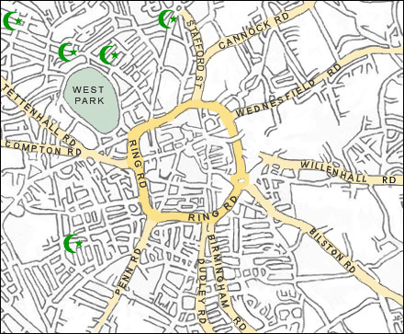
Mosques in Wolverhampton

Slide 12
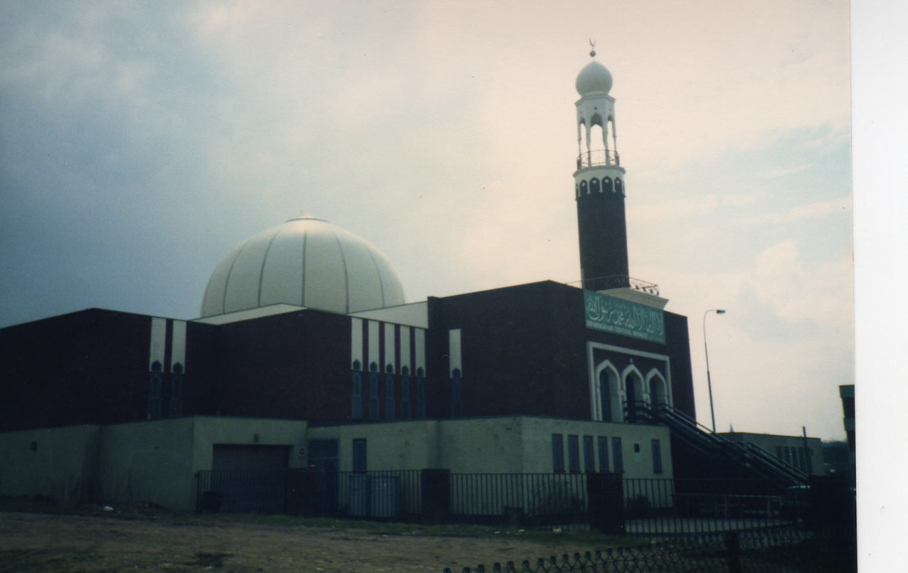
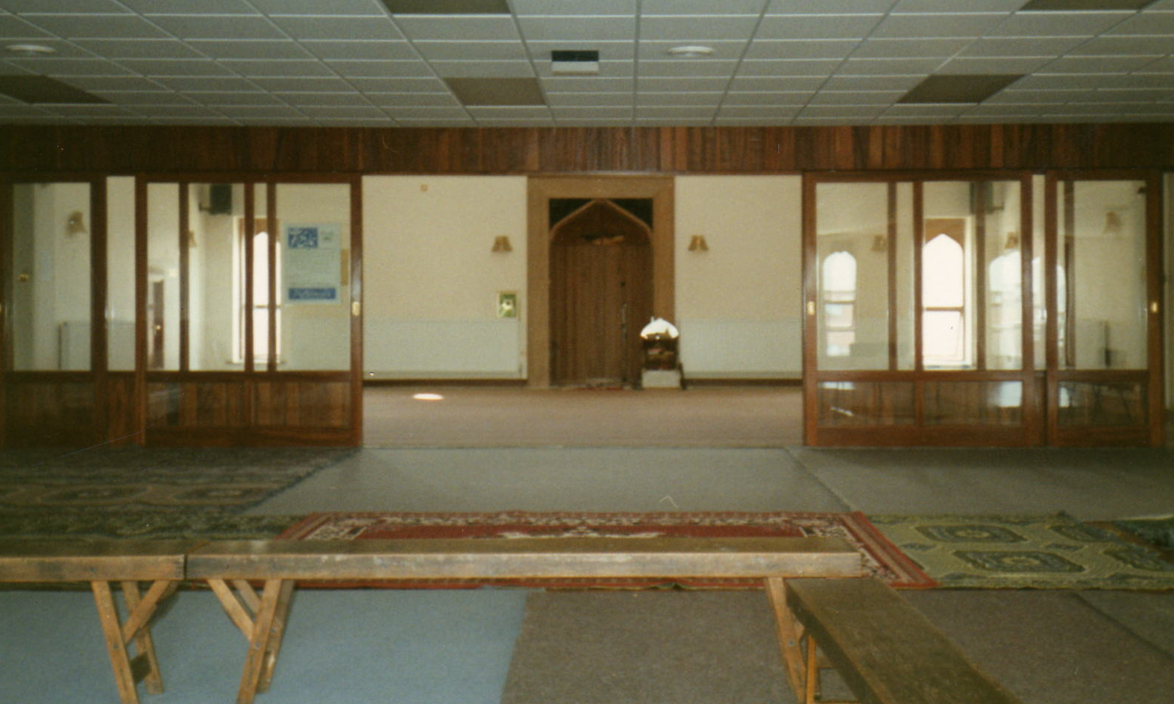
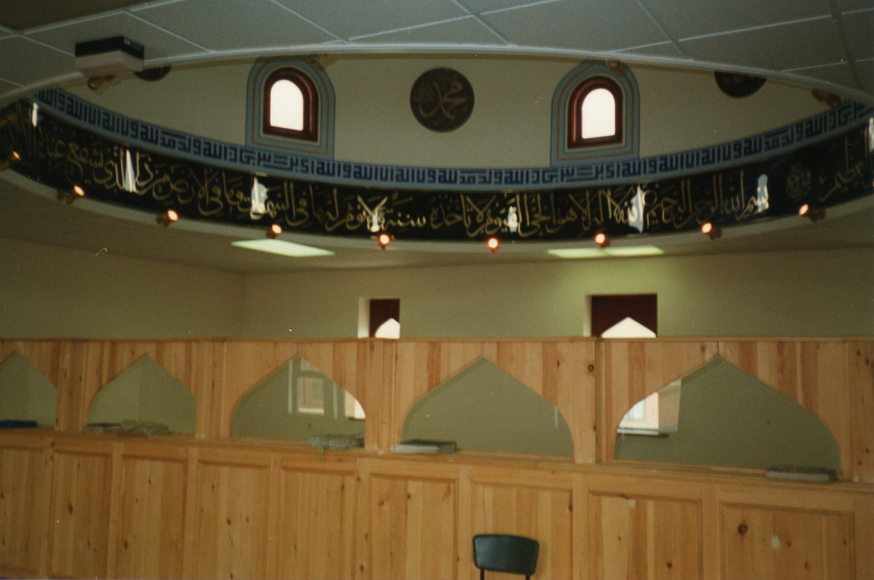
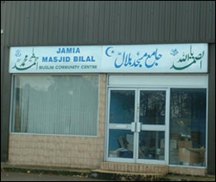
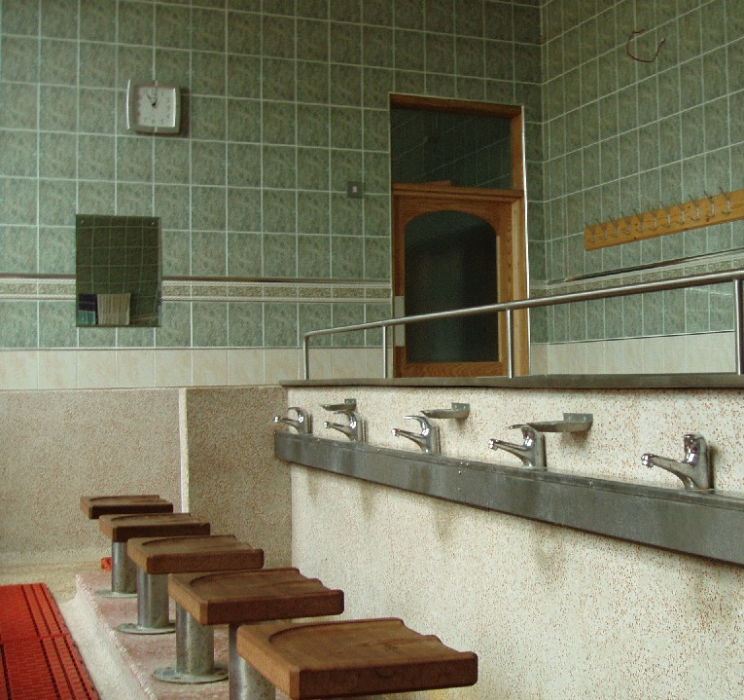
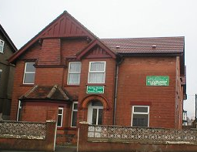
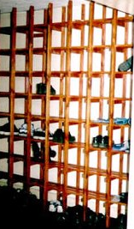
Images from mosques

Slide 13
Audio glossary
RE Online audio digest website: enter and select Islam for a glossary of key Islamic terms, spoken by a Muslim practitioner.
Words are spoken twice, then translated into English with an explanation.
For example, Adhan
Translation: “call to prayer,
Explanation: “from the same root muezzin, one who makes the call to prayer.” http://www.refuel.org.uk/reaudio/

Slide 14
2. Making contact
providing an overview of roles within Muslim communities to help making contact with the appropriate person. This overview will also unpack the titles to appreciate the standing of the person within the community, identifying formal qualifications and faith based recognitions.
Terms and their meanings
Most masjids will have an Imam who is the religious leader of the community. In addition, larger masjids will have a management committee, members of which may help with visits to the masjid.

Slide 15
3. Preparing students
formulating questions in advance
Etiquette- dress and conduct

Slide 16
4. Conducting the visit
identifying a range of religious and cultural sensibilities, unpacking stereotypes to avoid, and identifying reading to be undertaken before a visit/ interview so that time is spent on key insider perspectives. Will also cover what not to ask or how not to phrase questions.

Slide 17
Summary
specifying the purpose of your visit, preparing students both for etiquette and background knowledge.

