Slide 1
Open academic practice in action: research to teaching and back again in the OpenLIVES project
Kate Borthwick
Centre for Languages, Linguistics and Area Studies
University of Southampton, UK
OER13, Nottingham, March 26th, 2013
@Kborthwick @LLASCentre @elearnLLAS
LLAS
Centre for Languages, Linguistics and Area Studies University of Southampton
Southampton, SO17 1BJ +44 (0) 23 8059 6860 | @LLASCentre | www.llas.ac.uk

Slide 2
The OpenLIVES project
Learning Insights from the voices of Emigres (JISC)
Digitisation and open publication of research data
Creation of open educational resources based on the material
Embedding of the material, OERs and open practice in ongoing teaching
Collaboration: Universities of Southampton, Leeds and Portsmouth
www.humbox.ac.uk

Slide 3
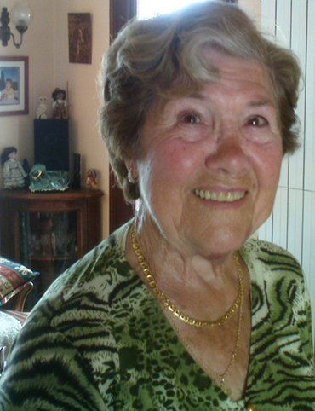
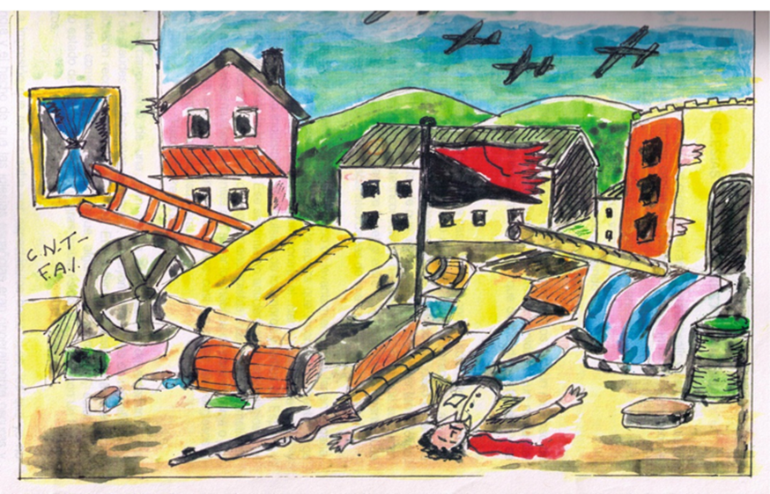
OpenLIVES research data
Wikimedia Commons Creative Commons Attribution-Share Alike 3.0 Unported

Slide 4
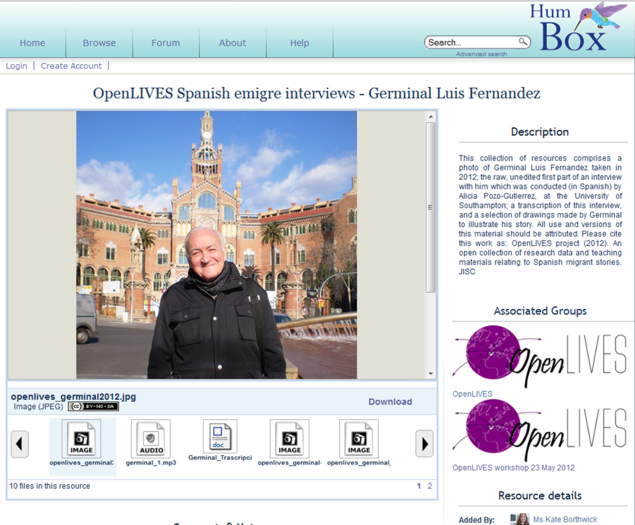
OpenLIVES: digitisation/publication
Provided original research
“I was totally seduced by the concept” - original researcher
Dealt with permissions issues
Digitising materials
www.humbox.ac.uk

Slide 5
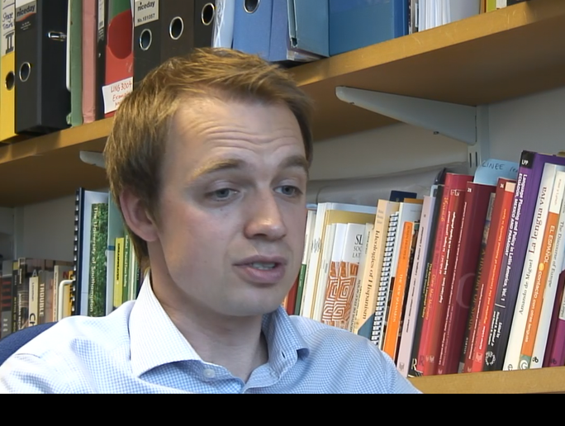
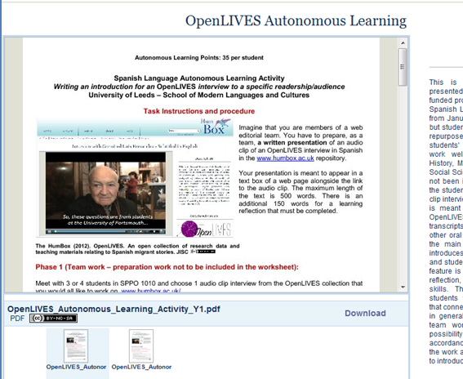
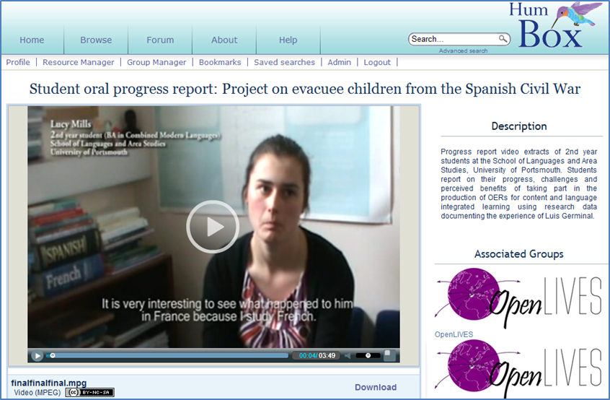
OER creation

Slide 6
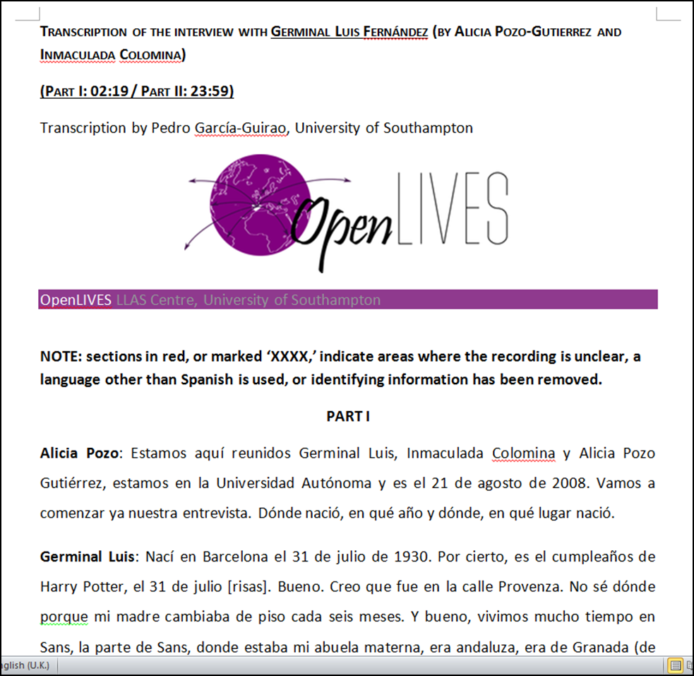
www.humbox.ac.uk

Slide 7
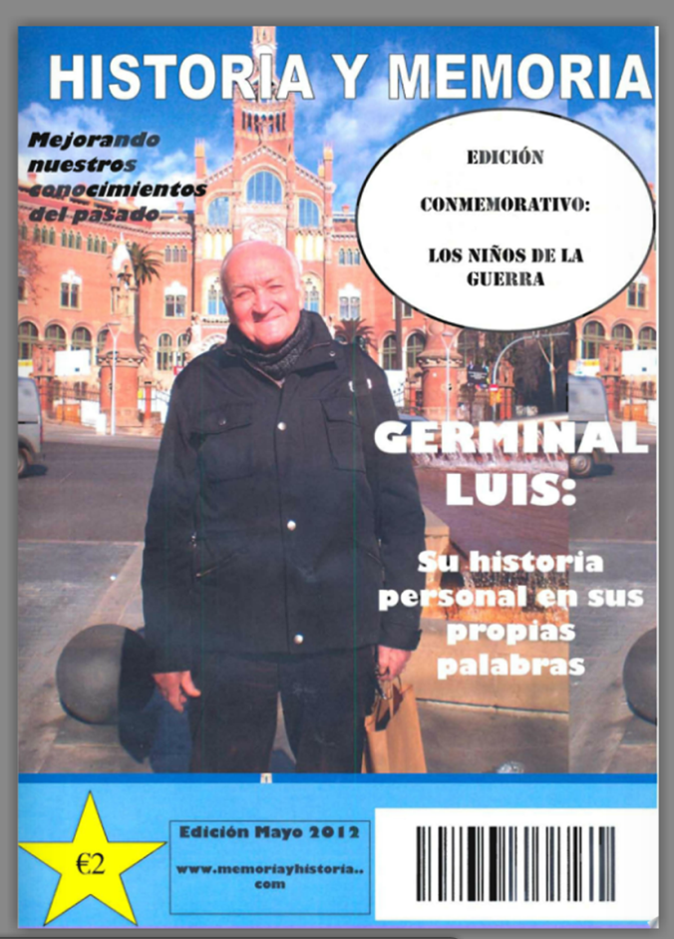
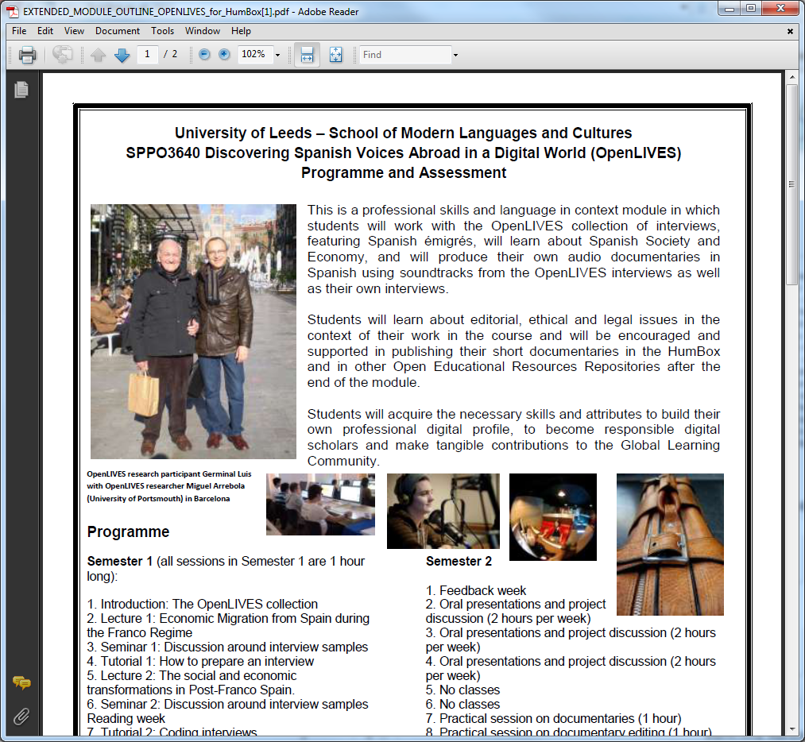
Embedding into practice
Southampton: research skills
Portsmouth: Languages for professional communication
- creation of interactive magazines
- relationship with Germinal
Final year module running this year: ‘Discovering Spanish Voices Abroad in a digital world’
- research, interview, technical skills
- creation of video documentaries
www.humbox.ac.uk

Slide 8
Student comments
“I would like to thank you for letting me work on this project. XXX's story is incredible and the last few weeks have been a little surreal - I feel like I have been sitting in his front room and also travelling in time!”- final-year undergraduate, Leeds
“We were a little bit of everything at the same time: transcribers, translators, proof readers and editors. We are really proud of the result!” – students at Southampton, who worked on the subtitling project
“I have really enjoyed the OpenLIVES module as it has given us, the students, an opportunity to do our own primary research and genuinely engage with the issues we are studying. Having more academic and creative control over our own education is extremely stimulating and motivating.” – final-year undergraduate at Leeds
www.humbox.ac.uk

Slide 9
OpenLIVES: summary
Preserving and doing justice to research data
Producing student-centred teaching resources
Curriculum innovation and originality in teaching
Beyond education
Collegiality and trust
Join the OpenLIVES group and use the resources at: http://humbox.ac.uk/group/2
See a video about the impact of the project at: http://www.youtube.com/watch?v=qeocSbDlfKE
www.humbox.ac.uk

Slide 10
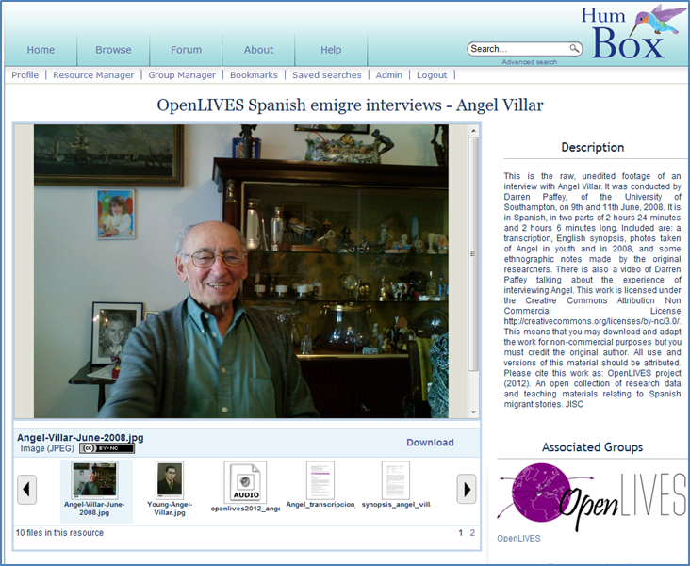
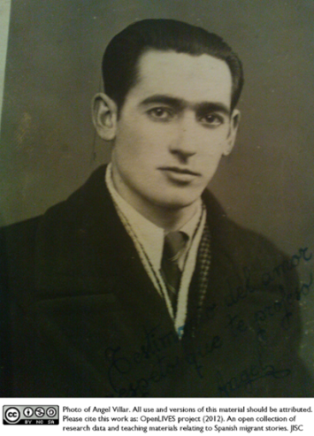
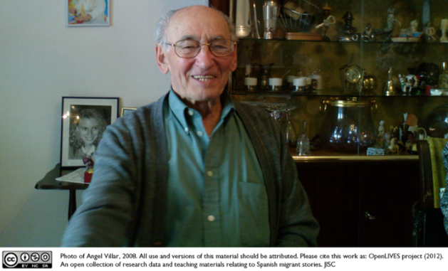
Thank you!
Thanks to JISC, the interviewees, our students and all who helped make OpenLIVES possible.
All materials at:
www.humbox.ac.uk
The OpenLIVES team:
Miguel Arrebola-Sanchez; Kate Borthwick; Alison Dickens; Pedro Garcia-Guirao; Antonio Martinez-Arboleda; Irina Nelson; Alicia Pozo-Gutierrez

