Slide 1
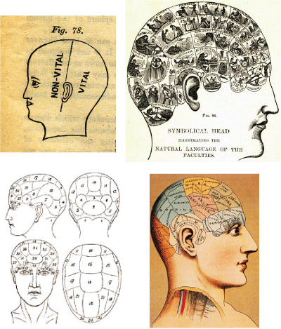
PHI 202
PHILOSOPHY OF MIND
Jane Suilin Lavelle
j.lavelle@sheffield.ac.uk

Slide 2
IMPORTANT
Change of seminar venue
Seminar Group A – Tuesday 4-5 is now in
BA-SR BB06 (Nursing building across the road)

Slide 3
Plan of the course
Weeks 1-4 | What is it to have a mental state? | Logical behaviourism
 |  | Identity theory
 |  | Functionalism
 |  | Eliminativism
Weeks 5-7 | How do we think about other people’s mental states? | Interpretivism
 |  | Naturalistic dualism and defeatism
Weeks 8-10 | What kind of content do mental states have? | Language of thought
 |  | Mental content
Weeks 11 - 12 | What is it to be conscious? | Consciousness

Slide 4
What’s going on this week
The Question:
What is it to have a mental state?
Logical behaviourism
Identity theory
Having a mental state consists in behaving in a certain way and having certain dispositions to behave.
?

Slide 5
Identity theory, eh?
Identity theory of physicalism
Identity theory claims that having a mental state consists in being in a particular physical state – i.e. Your brain is in a particular brain state.
For example:
Having the mental state of pain is to have the brain process of your C-fibres firing.
Having the sensation of a yellowish-orange after image is to have the brain process of your visual neurons firing in a certain way.
In so far as a sensation statement is a report of something, that something is in fact a brain process. (J.J.C. Smart, 1959: 145)

Slide 6
More on identity theory
Identity theory is:
A reductive account of mental states: it claims that mental states can be reduced to physical states
Incompatible with dualism
A form of physicalism – the view that everything we need to know about a mental state can be found out through the study of physical stuff.
Notes:
Three key facts about identity theory
In this lecture we’ll go through why each of these is the case.
Re Point two: identity theory is against dualism. Only one kind of stuff that makes up our mental states and that stuff is entirely physical.

Slide 7
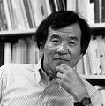
Exploring physicalism
Jaegwon Kim’s three minimal criteria for physicalism
(Philosophy of Mind, 1995)
1. Supervenience thesis
2. Anti-Cartesian principle
3. Mind-body dependence
Notes:
‘Mental states are physical processes. That is all.’ Obviously this means that physicalism is not compatible with dualism.

Slide 8
The supervenience thesis. Super.
The supervenience thesis
The mental supervenes on the physical in that any two things (objects, events, organisms, persons, etc.) exactly alike in all physical properties cannot differ in respect of mental properties. That is, physical indiscernability entails psychological indiscernability.
(Kim 1995:10)
In other words – if there is no physical difference between brain states then there is no psychological difference in mental state.
If another being is physically indiscernible from you, then you are psychologically identical too.
If you accept this thesis then you must reject Cartesian Dualism.

Slide 9
Supervenience thesis + Cartesian Dualism? No can do.
Why accepting the supervenience thesis entails rejecting Cartesian dualism
1. Let us imagine two Cartesian souls which consist entirely of immaterial stuff.
2. As these souls have no physical properties then we must say that they are physically identical (because they each have no physical properties).
3. The mind-body supervenience theory states that ‘Physical indiscernability entails psychological indiscernability’.
4. [from 2]. The two souls must be psychologically identical.
5. Either there is one Cartesian soul, or Cartesian Dualism is false.

Slide 10
Kim’s second criterion.
As most people who accept the supervenience thesis do not want to say that there is one Cartesian soul, they will accept that Cartesian Dualism is false. This implies...
... The anti-Cartesian principle
Kim’s second criterion for physicalism
Nothing can have a mental property without having some physical property and hence without being a physical thing. (1995:11)
I.e. There are no such things as immaterial souls.
Notes:
Emphasise the accepting the supervenience thesis does not entail that you accept the anti-Cartesian principle, but people who hold the former will usually hold the latter. The relation is nothing stronger than implication.

Slide 11
Kim’s third criterion. (No, really. The third criterion comes after his second. Reliable, isn’t he?)
Mind-body dependence
What mental properties a given thing has depends on, and is determined by, what physical properties it has. That is to say, the psychological character of a thing is wholly determined by its physical character. (p.11)
Explanatory tool
If mental properties are wholly determined by physical ones then changes in physical properties entail a change in psychological properties.
This means we can use changes in physical properties to explain changes in mental states.

Slide 12
Minimal physicalism
Supervenience thesis
Anti-Cartesian principle
Minimal physicalism
Mind-body dependence
If you reject any one of these principles then you are not a physicalist about mental states.
Notes:
So those are the three criteria which Kim required the physcialist to have. Reject any one of them and you cannot call yourself a physicalist.

Slide 13


The type/token distinction
There are two ways in which to interpret the claim that mental states are identical with brain states: they could be type identical or token identical.
How many dogs were at Crufts last year?
How many breeds of dog were there?
TYPE
How many dogs were there if you counted all of them?
TOKEN
Do you have Victoria Beckham’s dress?
Do you have a dress by the same designer?
TYPE
Do you have that very dress she is wearing in the photo?
TOKEN

Slide 14
The type/token identity
In saying that mental states are identical with brain states, then, we could be making one of two claims.
1. Each token mental state is identical with a brain state
My mental state of feeling pain yesterday at 2pm because of my stomach ache is identical with a brain state.
This is analogous to saying ‘the lightening strike last Tuesday was identical with an electrical discharge’.
Basing a research programme on this would involve looking for the exact brain state that correlates with the pain I had yesterday at 2pm because of stomach ache (for example).
It’s a weak thesis: all it says is that each token mental state is identical with some physical process.
Notes:
In saying that mental states are identical with brain states, then, we could be making one of two claims.

Slide 15
The type/token identity distinction
2. Every type of mental state is identical with a brain state
Each type of property that a mental state has is identical with a brain state.
E.g. My mental state of having a stomach-ache has the property of ‘pain’ which is identical with a brain state.
Analogous to saying ‘All lightening strikes (which are a type of weather phenomenon) are identical with electrical discharges (a type of physical phenomenon).’
It’s a stronger thesis than token identity physicalism because it is committed to physical states of the same type being identical with mental states of the same type. This makes it better for a research program.
Type-identity physicalism is the kind of identity we’ll be examining. It’s also known as type-type identity physicalism.

Slide 16
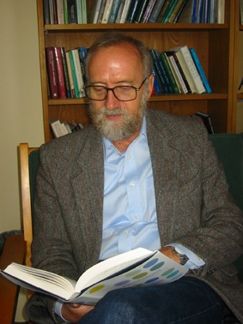
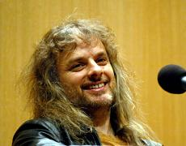

Part II: Problems with Physicalism
Physicalists
Mental states are identical with physical processes.
Having the belief that Kermit is green is to have a certain brain state.
Critics of physicalism
Mental states are not identical with physical processes
Having the belief that Kermit is green is to have a certain brain state and something else.
David Chalmers
Frank Jackson
Kermit

Slide 17
Problems with Physicalism: black and white Mary
Black and White Mary
Frank Jackson (1982) Epiphenomenal Qualia
Mary is a brilliant scientist who is, for whatever reason, forced to investigate the world from a black and white room via a black and white television monitor. She specializes in the neurophysiology of vision and acquires, let us suppose, all the physical information there is to obtain about what goes on when we see ripe tomatoes, or the sky, and use terms like ‘red’, ‘blue’, and so on. She discovers, for example, just which wavelength combinations from the sky stimulate the retina, and exactly how this produces via the central nervous system the contraction of the vocal chords and expulsion of air from the lungs that results in the uttering of the sentence ‘The sky is blue’. (p.471)
Will Mary learn anything when she leaves her room and experiences colour vision for the first time?
YES

Slide 18
Problems with Physicalism: black and white Mary
It seems just obvious that she will learn something about the world and our visual experience of it. (Ibid).
The Knowledge argument
1.
When Mary is still in the black and white room she knows all the physical information about how colour vision works.
2.
When Mary steps out of the black and white room she learns something new about colour vision.
3.
If [2] is true then physicalism is false.
Physicalism can only be true if, when we have the complete physical knowledge about a brain process like, for example, colour vision, then there is nothing more to learn about it.
Question: What is it that Mary learns?
Answer: The QUALIA of COLOUR VISION.

Slide 19
Qualia
Qualia
‘Qualia’ means the ‘what it is like’-ness of an experience.
What Mary gains upon leaving the black and white room is the quale (singular) of colour vision – what it’s like to see colour.
Jackson’s argument:
1.
Qualia are a property of mental states.
2.
Physicalism (of any kind) cannot account for qualia.
3.
Physicalism cannot provide a complete account of mental states.

Slide 20
Qua-qua-qua-quali-aaaah
If qualia are not physical (because they are not accounted for in the physicalist’s account of mental states), then...
...What do qualia consist in?
Qualia are epiphenomenal.
Epiphenomenal?
An epiphenomenal view of mental states claims that
Mental states have certain properties which are not physical
These properties are caused by physical processes...
...but they have no power to affect physical processes

Slide 21
Epiphenomenal Qualia
Other non-physical stuff
e.g. other qualia
Non-Physical stuff
e.g. Qualia
CAUSE
CAUSE
Physical processes
(e.g. neurons firing)
CAUSE
Other physical processes

Slide 22
Objections to epiphenomenal Qualia (i)
Clearly qualia affect our behaviour
When I complain about my stomach-ache, it just makes sense to say that it is my qualia of pain which is causing me to groan, clasp my stomach, say that I am in pain, etc. What, if not my qualia, is causing me to do this?
Response
Why assume that it is qualia which cause this behaviour?
It is compatible with the epiphenomenalist’s view to say that brain processes cause pain behaviour.
The fact that qualia and pain behaviour occur together does not necessarily mean that qualia causes pain behaviour

Slide 23
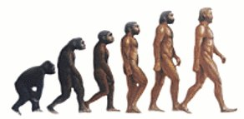
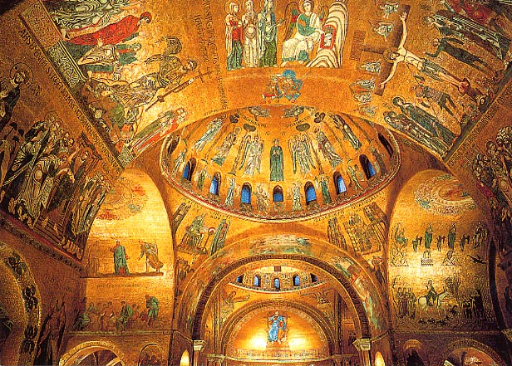
Objections to epiphenomenal Qualia (ii)
Evolution argument
Why would something which has no causal power over physical processes evolve?
Response
Qualia were not directly selected for – they are a by-product of other evolutionary processes.
Spandrels of San Marco
Gould and Lewontin (1979)
The spandrels were not designed in order that the evangelists could be painted there.
Analogously, the brain was not selected for in order for qualia to exist.
There is no reason for qualia to exist any more than there is a reason that the paintings of the evangelists exist.

Slide 24
Objections to epiphenomenal Qualia (iii)
Problem of other minds
I infer what people are feeling or thinking from the behaviour which I see.
How can a person’s behaviour provide any reason for believing he has qualia like mine, or indeed any qualia at all, unless this behaviour can be regarded as the outcome of the qualia?
Jackson (1982:475)
Response
An analogy
I can read in The Times that Hull beat Newcastle 1-0.
I also read in The Guardian that Hull beat Newcastle 1-0.
However, I don’t assume that The Guardian got its information from The Times. Rather, I assume that it is the event of Hull winning which caused the two reports.
Link with behaviour
Standing on a tack causes pain behaviour. It will also cause pain qualia. The cause of the behaviour is not the qualia, but the event of standing on a tack.

Slide 25
Objections to epiphenomenal Qualia (iii)
The Times reports that Hull beat Newcastle 1-0
The Guardian reports that Hull beat Newcastle 1-0
Hull beat Newcastle 1-0

Slide 26
Objections to epiphenomenal Qualia (iii)
Matt shows pain behaviour
Matt has the qualia of pain
Matt is in the physical brain state of pain

Slide 27
Objections to epiphenomenal qualia (conclusion)
We have seen three objections to the view that qualia are epiphenomenal:
Argument from causation
Argument from evolution
Argument from other minds
NEXT: Paul Churchland’s criticisms of the ‘Black and White Mary’ thought experiment.
Notes:
To recap how we got to this point:
Physicalism
Black and White Mary as instance of physicalism not working.
Claim that qualia are a non-physical property of mental states and Mary cannot gain them from her physical knowledge.
Now we’re going to look at response to the Mary thought experiment from Paul Churchland.
Defence of the claim that qualia

Slide 28
Churchland objections
The Problem
Churchland (1986) thinks that Jackson’s Black and White Mary story does not show that physicalism is false.
Two (main) Objections
Qualia are simply a ‘different kind of knowledge’
Challenges the claim that no matter how much physical information Mary has about colour vision she will not have its qualia.

Slide 29
Churchland objections (i)
Different kinds of knowledge
Mary acquires all the physical information there is to obtain about what goes on when we see ripe tomatoes, or the sky... (Jackson 1982 p.471)
Churchland says that the above claim is false.
Mary may have all the propositional knowledge available but this does not equate to having all the physical knowledge available.
Some knowledge may not become available until you are acquainted with the object in question...
...but that does not entail that such knowledge is not physical.

Slide 30
Churchland objections (ii)
Why should we accept that Mary will learn something?
Working within our current limits of neuroscience it may well be that once Mary knows all that we know about vision she will still learn something new upon leaving the room.
For example, we may be able to stimulate her brain to be in the same state as it would be if she were seeing red...
...One test of her ability in this regard would be to give her a stimulus that would (finally) produce in her the relevant state (viz., a spiking frequency of 90hz in the gamma network: a “sensation of red” to us), and see whether she can identify it correctly on introspective grounds alone, as “a spiking frequency of 90 hz: the kind a tomato would cause.” Churchland p.26
This seems entirely plausible, and highlights the contrast between different kinds of knowledge, again.

Slide 31
Conclusion (sorry, there’s no way to make this bit interesting)
Conclusion
We looked at identity theory, which is a form of physicalism.
Then we looked at Jackson’s challenge to physicalism, namely, that it cannot account for the qualia of experience.
We examined Jackson’s account of what qualia consist in...
...And some objections to that account.
Finally we looked at Churchland’s claim that physicalism CAN account for the qualia of experience.

