Slide 1
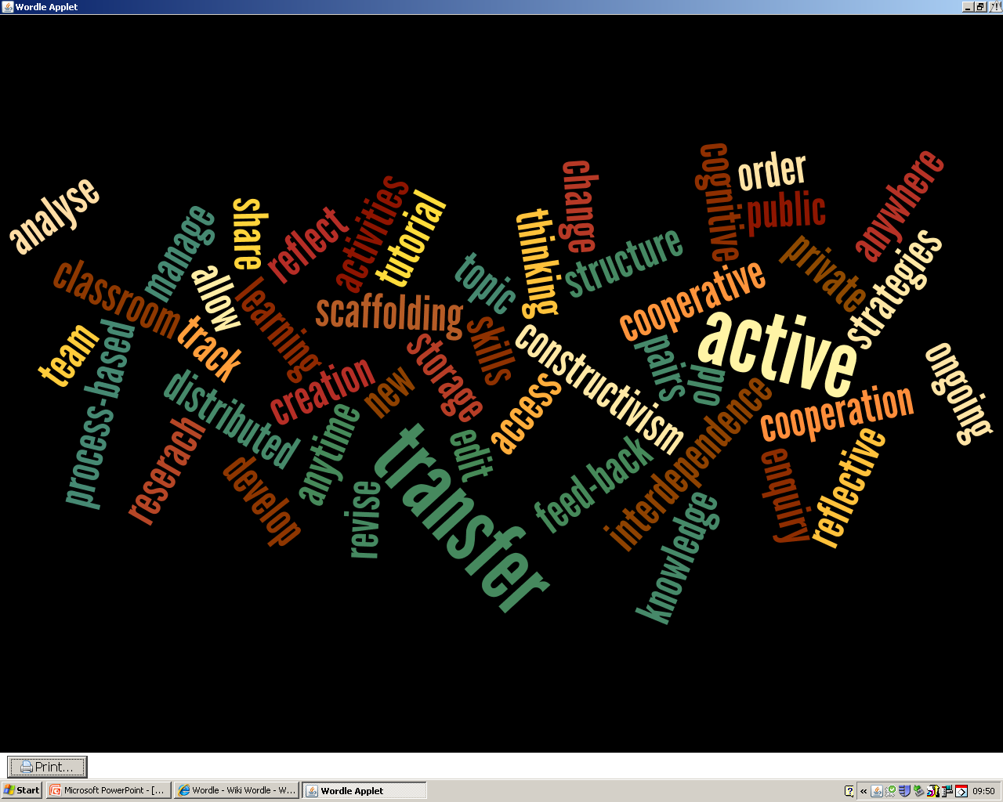
Week 2: Wikis For Language Learning
The word ‘wiki’ derives from the Hawaiian ‘wiki-wiki’ meaning ‘ very quick’
Wikis were first invented in 1994 by Ward Cunningham
Wikipedia, the collaboratively created encyclopaedia was launched in 2001. This popularised the wiki and its applications to the general public

Slide 2
Videos explaining how a wiki works
Wikis in Plain English
How to create pages, edit them and link to other pages in the wiki, using the simple example of organising a camping trip.
http://www.youtube.com/watch?v=-dnL00TdmLY
World of Wikis.
Similar in theme, pointing out the advantages of using a wiki as opposed to e-mail. http://www.youtube.com/watch?NR=1&v=3GmRZrWyFDk
Establish a Classroom Wiki.
Very clear explanation of how to create a wiki and arrange the settings so as to establish who may or may not have access. http://www.youtube.com/watch?v=wXk5_PhdpzM&feature=related

Slide 3
Task 1
As you know, buying and ordering food items form the basis for standard practice tasks at beginners’ language level. These take place in transactional contexts: i.e., role-plays and exercises imitating the purchase of these products in the target culture
How can these sorts of themes be transformed and expanded using a wiki?
Create a wiki with your learning partner, with ‘Establishing a Wiki’ as your guide. Using the ‘Edit’ and ‘Save’ buttons create three lists: what food you have in the house, and what food you need.
Your learning partner will then make a list of the estimated prices.
Then both of you edit your partner’s lists, and adjust the prices if you don’t think they are accurate.

Slide 4
So what has made wiki and its applications such a phenomenon? Because it combines the two functions I talked about last week
It is a reference tool and knowledge management system: it stores, archives and searches data information, and documents which can be easily retrieved by anyone. It was described by its founder as: ‘The simplest online database that could possibly work’
But at the same time it is also an interactive authoring tool: it enables user-created, user-led creation, production and distribution of content on the internet.
A wiki is thus a collaborative online working environment.

Slide 5
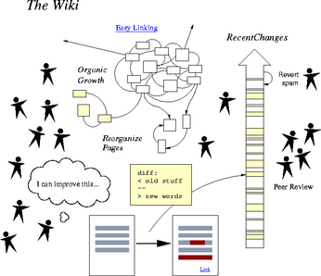
A wiki is characterised by its open architecture

Slide 6
What does the above picture tell us about the characteristics of wikis?
Wikis can be created, edited and accessed by one, several or many people, with no limits on who participates.
Thus they are fundamentally a collaborative phenomenon, whether between pairs, groups or classes.
All pages can be edited, revised and changed by the wiki’s participants.
All pages are easily linked, thus creating meaningful topic associations within the wiki.
All activities on the wiki are tracked, recorded and shown in chronological order on the wiki’s ‘History’ page.
It is also possible to insert pictures, videos and other resources into the wiki.
Article on what wikis do:
http://net.educause.edu/ir/library/pdf/ELI7004.pdf

Slide 7
Learning Environments 1: Distributed Learning
There are no guarantees anymore that students will be gathered together in one dedicated place, and can safely be taught within the space of the teaching classroom. Your groups of students might be located on different campuses, for example, and distance learners are an increasingly important component of educational environments.
A wiki is one way of providing these students with an infrastructure, connecting the learners and working with them in a managed environment.
Also, as we have seen from the BBC website, education and learning is increasingly taking place in many different contexts outside the formal classroom. You could see that groups quickly form into online learning communities, dedicated to exchange of information and discussion around one topic or language theme.
The BBC website also illustrates the another aspect of distributed learning: diffusion of learning itself into many other areas of human activity, including leisure pursuits. This, of course, creates other possibilities for a wiki.

Slide 8
Learning Environments 2: Scaffolded Learning
Student enquiry, research, investigation, projects
Questions, methods and processes developed by students
Instructional organisation and support
An appropriate learning environment
Direction, orientation and purpose
Teachers creating momentum, suggestions, sources, correcting and clarifying

Slide 9
What learning methodologies and practices can a wiki support?
Learner interdependence
Interaction
Collaborative
Process
Constructivist

Slide 10
Learning methods 1: Process-based learning: knowing how to learn as well as what to learn
Composition as a process
Student involvement in writing
Revising
Post-writing
Retrospective reflection
Constructive feedback from peers and teachers
Prewriting
Drafting
Editing
Reflective students aware of their own learning process

Slide 11
Learning Methods 1: Constructivist Learning
Building on the experience and knowledge a student already has ...
Learning is an active process: students learn by doing and observing ...
Students create new meanings from previous and acquired knowledge

Slide 12
How exactly can a wiki support these two models of constructivist learning?
SOCIAL CONSTRUCTIVISM
(Lev Vygotsky)
Learning takes place through interaction with social and cultural contexts, and through active discovery of these contexts
COGNITIVE
CONSTRUCTIVISM
(Jean Piaget)
Learners build knowledge through experience. They build schemas: mental models of the world, through two processes: assimilation and accommodation

Slide 13
Some articles about these learning environments and methods
Scaffolded learning and its
purpose:
“Scaffolding Learning”. Adapted from Wilheim, Jeffrey, Tanya Baker and Julie Dup (2001) Strategic Reading: Guiding Students to Lifelong Literacy. London: Heinemann. http://www.myread.org/scaffolding.htm
Constructivism for teaching and learning:
“Constructivism as a Paradigm for Teaching and Learning”. Website explaining the concept of constructivism, with demonstrations and examples as to how you go about constructing a class: http://www.thirteen.org/edonline/concept2class/constructivism/index.html
The theory and practice of constructivism; a website which does what it says on the tin, and sums up the main premises of constructivist
teaching and learning, with background theory
Elizabeth Murphy (1997) website: ‘Characteristics of Constructivist Teaching and Learning’ ‘http://www.ucs.mun.ca/~emurphy/stemnet/cle3.html
Building online learning communities with a wiki: this is a wiki entitled ‘Distributed Communities of Practice’ which discusses connectivism, constructivism and other relevant concepts:
Andy Coverdale, University of Nottingham (2009) ‘Distributed Communities of Practice’ http://sites.google.com/site/andycoverdale/texts/distributed-communities-of-practice
Blended learning and using wikis to create an online learning environment
Marija Cubric (2007) “Wiki-based process framework for blended learning” WikiSym ‘07 –Proceedings of the 2007 international symposium on wikis
http://dl.acm.org/citation.cfm?doid=1296951.1296953
Process-based learning:
“Processed-based learning: a model of collaboration” Jane Connell and Pam Seville. Pdf document. http://ojs.acadiau.ca/index.php/AAU/article/viewFile/88/54

Slide 14
Using Wikimedia and other free copy-right cleared resources
The following video is an excellent
example of what you should NOT do:
How to insert a picture or an animation into a
wiki:
http://www.youtube.com/watch?v=pUs25wdF
Dw&feature=related
Wikimedia provides an abundance of free
resources, images and videos, without the need
to violate copyright. This also introduces us to another
related concept, the commons: freely sharing and
distributing resources for the common good.
http://commons.wikimedia.org/wiki/Main_Page

Slide 15
Task 2
Open up your wiki again. As demonstrated in the ‘Wikis in Plain English’ video, create a location page, describing the name and location of your local supermarket, and link it to your main page.
Go to Wikimedia and locate an appropriate image or photo of some food item or meal. Then insert it into your wiki homepage.
Now reflect on what other sorts of exercises or activities could be created using this theme.

Slide 16
Other types of wiki facilities
Answers.com: Wiki Answers. This site allows you to post a question on any topic under the sun and receive answers from the global online community. Have a look: http://wiki.answers.com/
This website gives you a list of wiki applications: http://web.appstorm.net/roundups/communication-roundups/10-top-web-wiki-applications/

