Slide 1
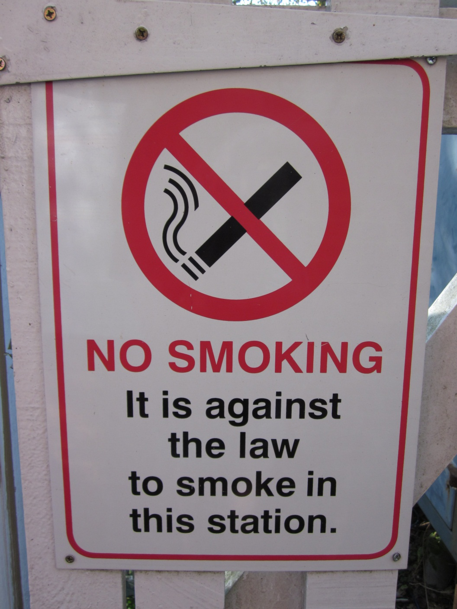
Interpreting our environment and culture through signs

Slide 2
What exactly is semiology?
Semiology derives from semiotics. Semiotics is the theory, science or analysis of signs. We all live in an environment consisting of numerous signs which convey meaning to us. We have to interpret them in order to understand our environment.
Public signs consist of universally recognised images together with short text.

Slide 3
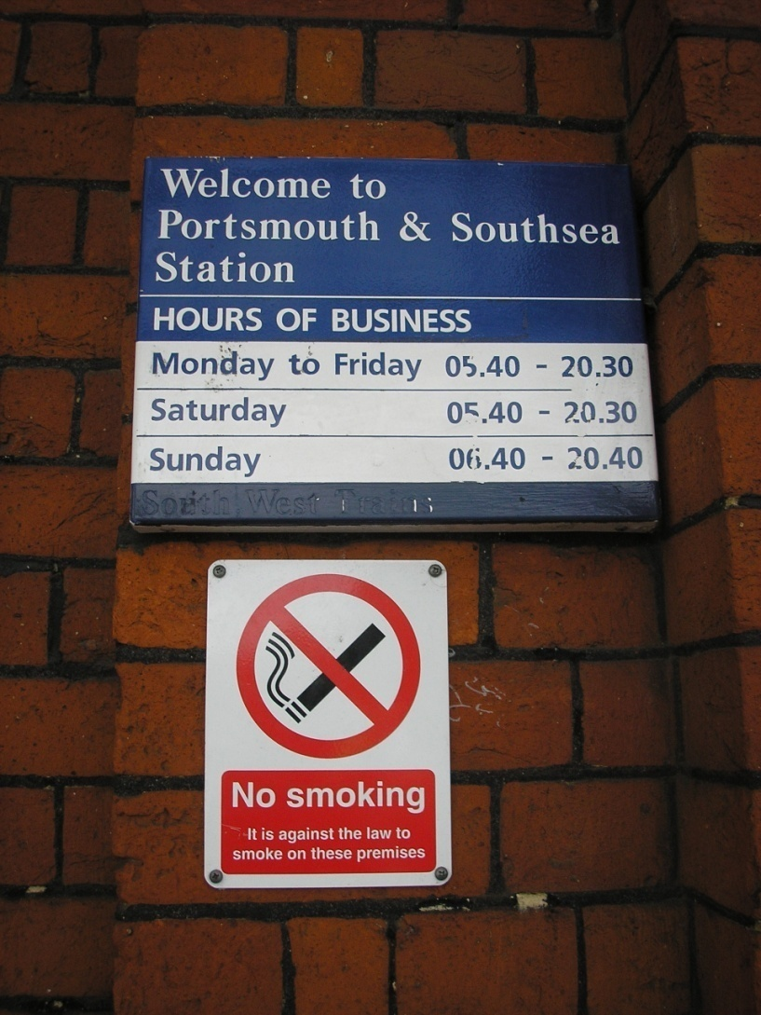
Public signs regulate our access and use of space

Slide 4
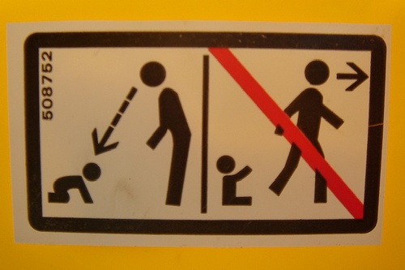
Public signs regulate our behaviour

Slide 5
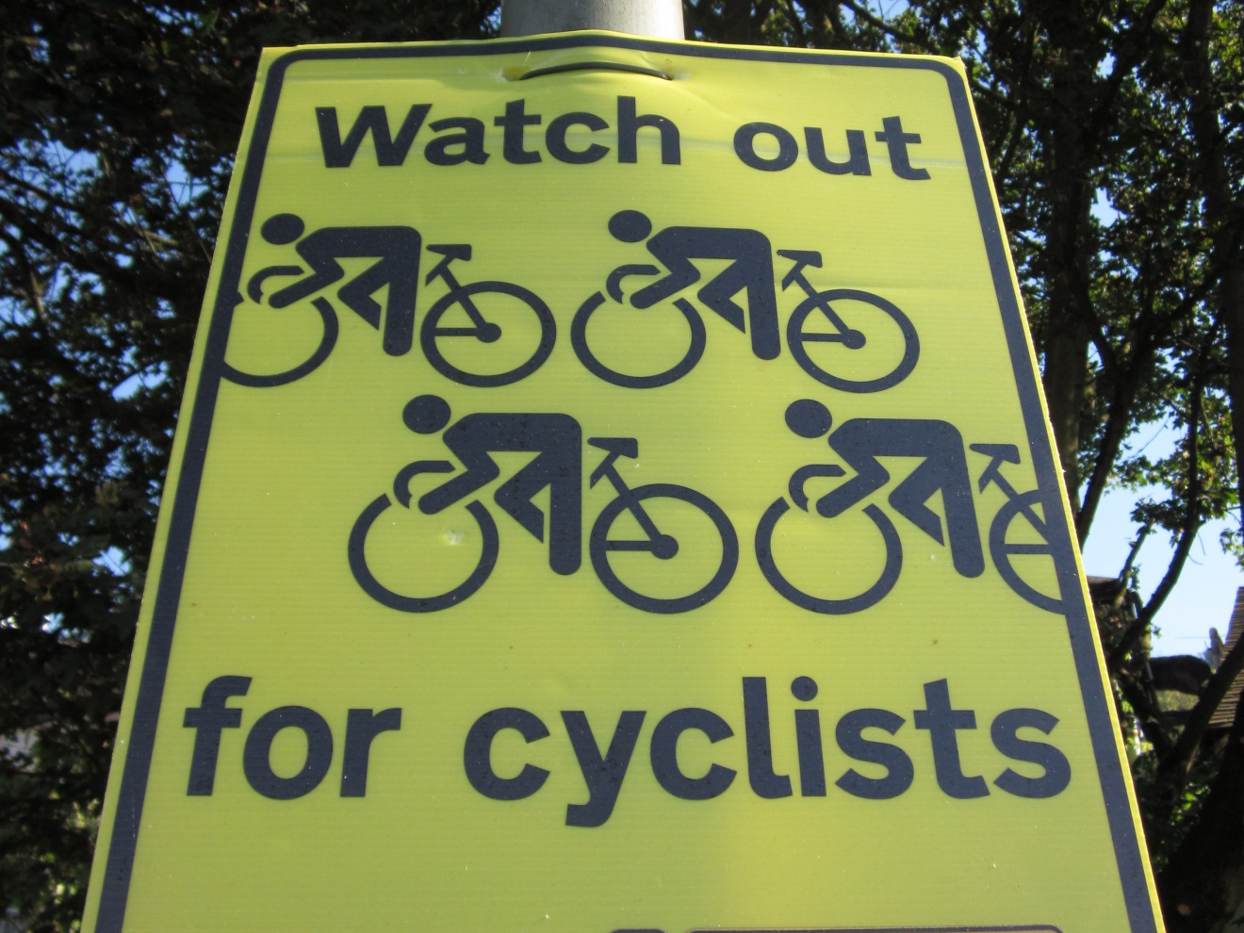
This photo was taken on a public footpath in a well-known tourist location.
What message is the sign in the photo conveying? What do the images indicate? What is the significance of the colour yellow?

Slide 6
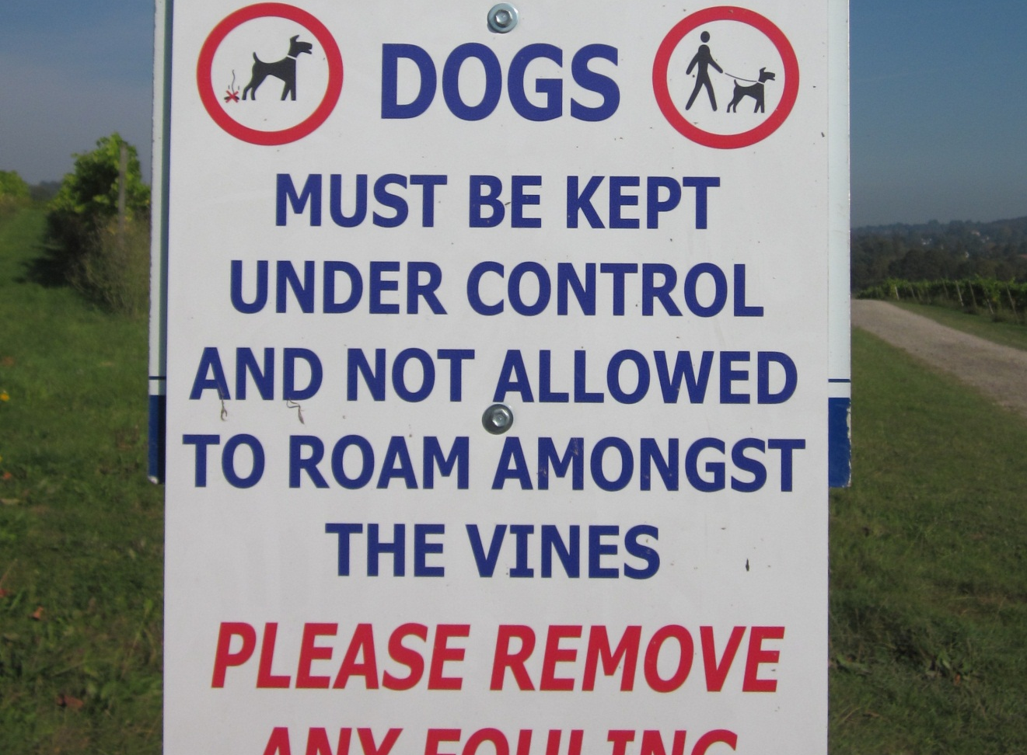
This photo was taken in an agricultural area with limited public access.
What does the colour red convey? What is the meaning of the red circle? What is the colour blue used for? What information is given about what you should or should not do with dogs?

Slide 7
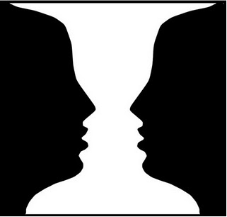
Why is this subject important?
What two images are contained in this picture?

Slide 8
We – human beings – make meaning through our creation and interpretation of signs
The picture above is a sign, but it is ambiguous: it has a dual meaning. It could convey a vase, or two faces.
So it is important, in a social context, to know what signs mean, and, the more we know about signs, the better we can interpret our environment.
We are now going to look at semiology as a tool that can be used to “see” the structure of key aspects of society and all the social, cultural and historical aspects that have formed it.

Slide 9
According to Ferdinand de Saussure (1857 – 1913), a sign takes two parts:
The signifier: the form that the sign takes
The signified: the concept that the sign represents

Slide 10
Signifier
Signified
The sign is the whole that results from the union of the signifier with the signified

Slide 11
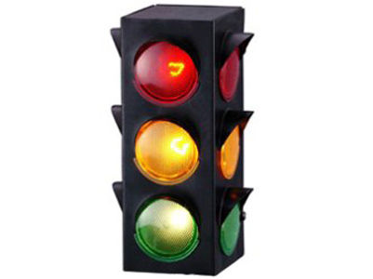
Let’s stick with colours as an example.
As we’ve already seen, colours have certain associations, as in this picture of traffic lights.

Slide 12
What does this sign consist of?
The signifier is the colours used: red, yellow, green
The signified is the instructions given to car drivers
Signifier: red
Signifier: yellow
Signifier: green
Signified: Stop !
Signified: Wait!
Signified: Go!

Slide 13
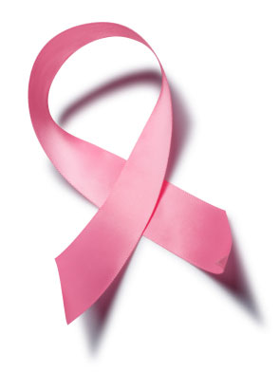
Another example: the pink ribbon
In Britain, pink is
commonly held to be a
feminine colour. So we
know this has to do with
a feminine subject.
This item is also a
ribbon, something you
wear on your clothes,
thus giving it another
feminine connotation.

Slide 14
Connotations of the pink ribbon
The ribbon is a modern-day practice of wearing something to promote something or raise awareness of something. This something is often an issue or event in society – you want to signal your solidarity and understanding of this event.
In Britain, this ribbon is worn to raise awareness of breast cancer, a disease common in society, but for which there is no cure as yet. So it is necessary to raise awareness, and also money.
You can show your solidarity with this cause by wearing the pink ribbon.

Slide 15
This pink ribbon illustrates the sign as triangular: a relationship between three components:
Object
(the pink ribbon)
Representation
(awareness of breast cancer)
Interpretation
(feelings of empathy, solidarity with sufferers of this illness)

Slide 16
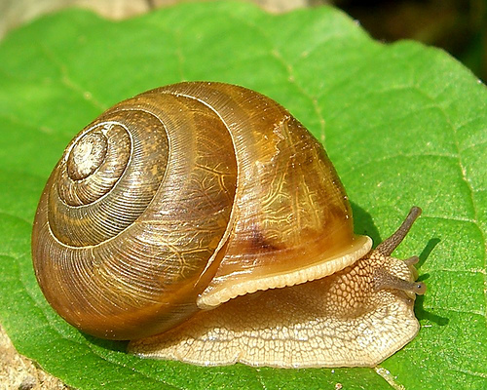
What is the origin of these universally recognisable signs?
Some are derived from our relationship with the natural environment and the symbols we create from it. They are natural signs.
What is this creature, and what in our minds does it represent?
‘At a snail’s pace’
“Snail mail”

Slide 17
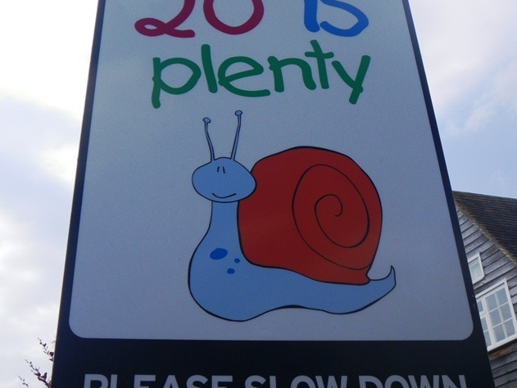
This picture was taken by a road in a small village in Hampshire, next to a school. The caption reads at the top: “20 is plenty”, and at the bottom, “PLEASE SLOW DOWN”
What message is this sign trying to convey, and in what context?

Slide 18
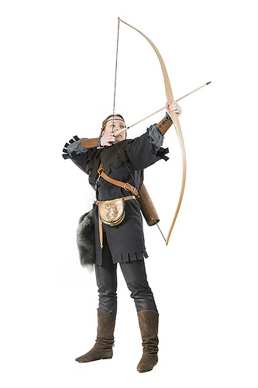
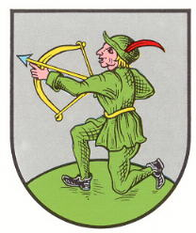
Some signs derive from a very common ancestry. Here is a picture of the weapons, the bow and arrow, which were used for hunting for food, fighting and defence since prehistoric times to the seventeenth century, in many civilisations around the world.

Slide 19
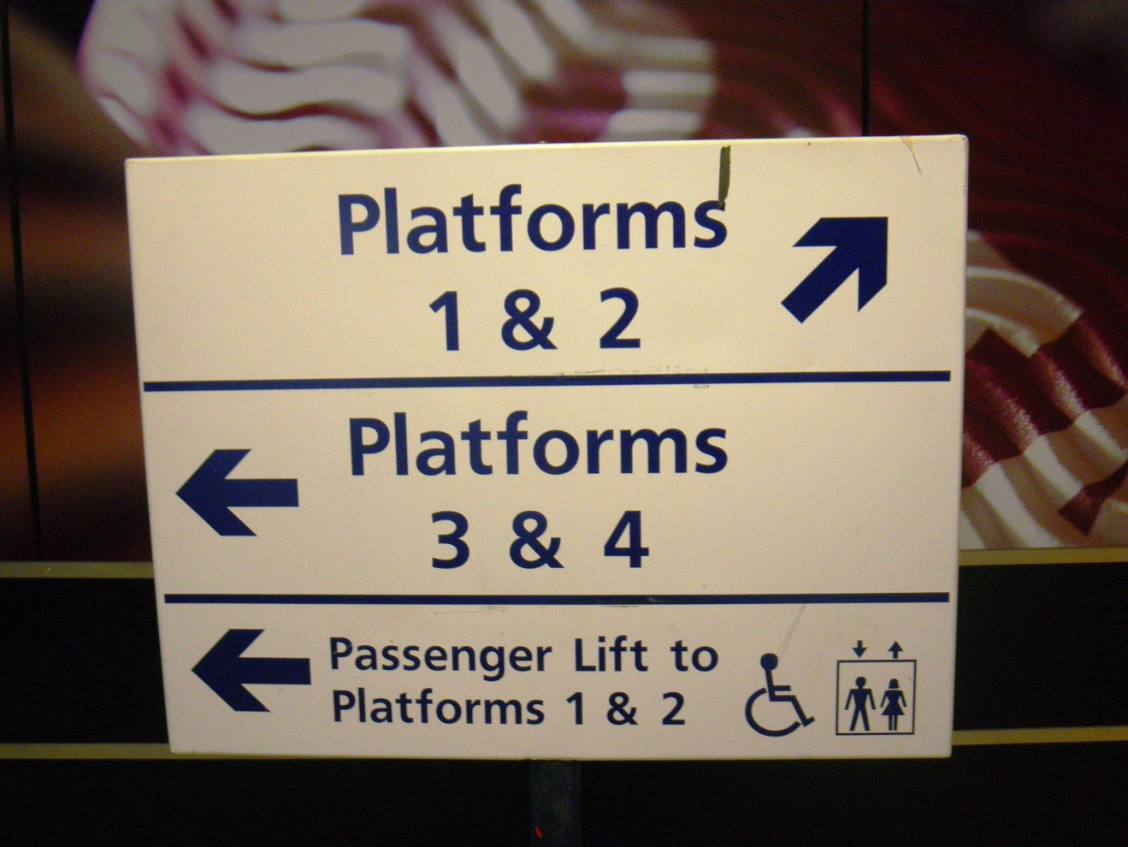
A sign using arrows to indicate direction
The hunter-gatherer society is gone, but the ancestral memory remains in the signs we use. The arrow is now used to position us and orientate us in relation to the places in our environment: it has a synchronic function.

Slide 20
So signs have a synchronic and diachronic aspect
Synchronic: the relation of things in space
Diachronic: things evolving through time
A sign: the intersection of our relation with space and time

Slide 21
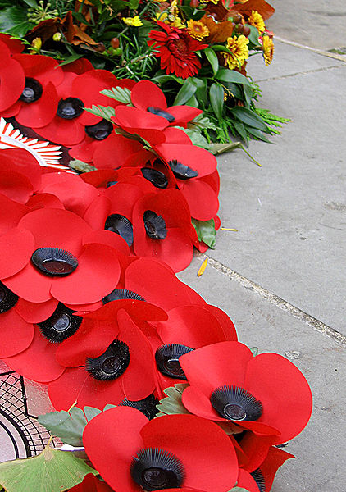
These poppies commemorate Remembrance Day
Remembrance Day traditionally takes place in November (November 11).
It commemorates an historical event, World War 1, which lasted from 1914 - 1918

Slide 22
Remembrance Day
At least 722,000 British men died in World War 1. The sale of these poppies every November raises money for the British Legion, an association which looks after soldiers and their families.
The poppies represent the flowers growing on the fields where much of the actual fighting took place.
Remembrance Day at the Cenotaph:
http://www.youtube.com/watch?v=pSol1JxSniU

Slide 23
Thus the poppy has many connotations:
Blood, signifying death
Red, signifying blood
Flowers meaning rebirth after death, the beauty of life
A place in Europe – the fields with flowers where men died
These all form a chain of signifiers – but the principal signified is war, and the death of men.

Slide 24
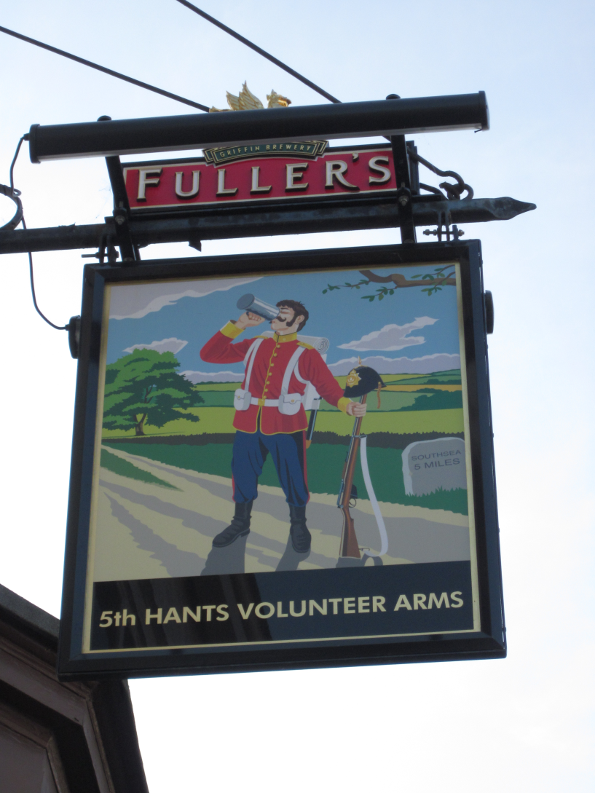
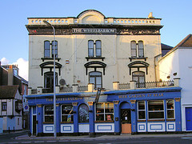
Let’s take another example of a sign that can be used to interpret British history: the pub sign

Slide 25
Why do all pubs, without exception, display a sign?
A British public house is where people and communities go to have a social drink and a meal, and is often a place where travellers stay the night. Pubs were first established in Britain 2,000 years ago, and many pubs and their names have been in existence for hundreds of years.
Each pub has a sign, with a title and a picture. The reason for this is that many people could not read or write, so a picture was necessary.
Pubs were named after distinguished people or royal families (The King’s Head), professions or sports (Fox and Hounds) or where they are situated (The Station Arms)

Slide 26
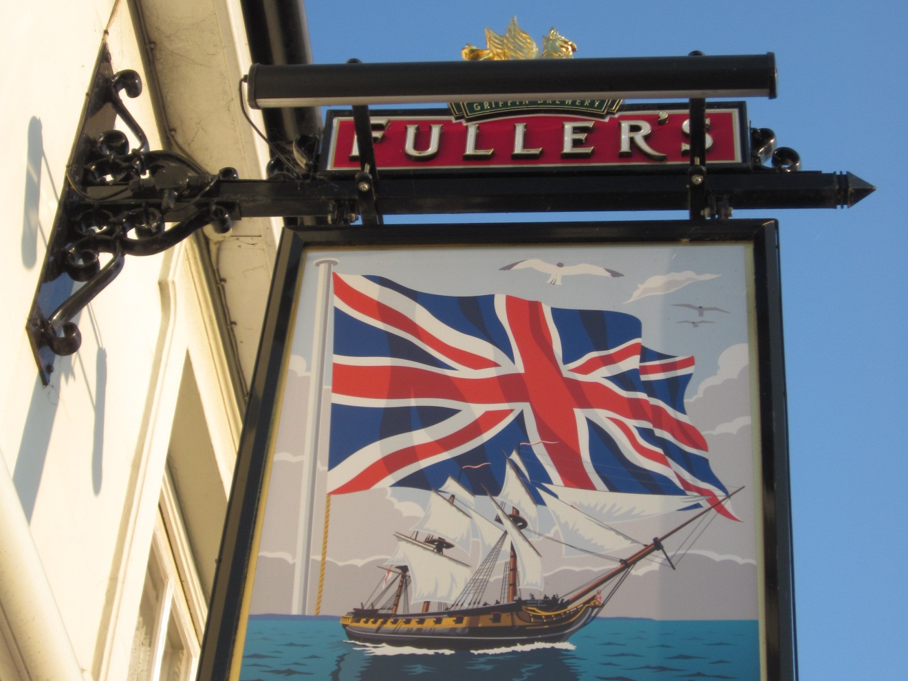
This is a local pub, the Red, White and Blue. Why do many pub signs in Portsmouth represent historical ships?
This sign and its title shows very clearly the intersection between the national and the local

Slide 27
Elaine Saunders, “A History of Britain in its Pub Signs Parts I and 2” http://www.timetravel-britain.com/articles/history/pubsigns1/shtml http://www.timetravel-britain.com/articles/history/pubsigns2/shtml
“Pub signs are like snapshots from time, every one of them capturing an historical event or era”.
Pub signs are synchronic and diachronic: they are located in relation to their neighbourhood and community, and show changes and events in local and national society over time.
Diachrony is time, history, process and change.

