Slide 1

Using, developing and sharing your teaching resources
Kate Borthwick
Centre for Languages, Linguistics and Area Studies
University of Southampton
LLAS
Centre for Languages, Linguistics and Area Studies
University of Southampton
Southampton, SO17 1BJ
+44 (0) 23 8059 6860 | @LLASCentre | www.llas.ac.uk

Slide 2

Overview
Technology in your teaching
Sources for finding useful material online
Sharing your own resources openly with the world
Some tools

Slide 3
Question:
What kinds of technology do you already use with your students?

Slide 4
Question: what kinds of technology do you already use with your students?
Email
internet
VLE (Blackboard, WebCT, Moodle)
social networking e.g. Facebook, youTube, Twitter
collaborative tools (Wikis, Google docs, blogs)

Slide 5
You can’t ignore technology…
Nature of teaching and learning in HE is changing:
diverse student body requires different modes of delivery – distance, self-study, larger class sizes.
students use technology extensively in ‘real-life’
institutional demands e.g. e-learning strategies, mandatory use of certain technologies
new funding models and new expectations
funding Council/Government priorities e.g. open educational resources

Slide 6
What are Open Educational Resources?
"OERs are teaching, learning and research resources that reside in the public domain or have been released under an intellectual property license that permits their free use or re-purposing by others.”
- Report for the William and Flora Hewlett Foundation

Slide 7











The ‘OER’ movement

Slide 8
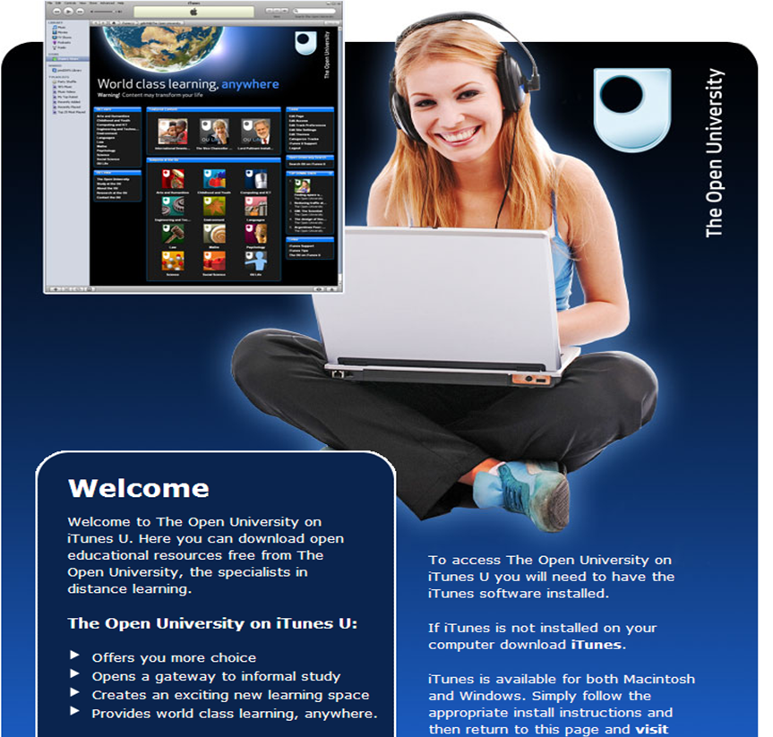
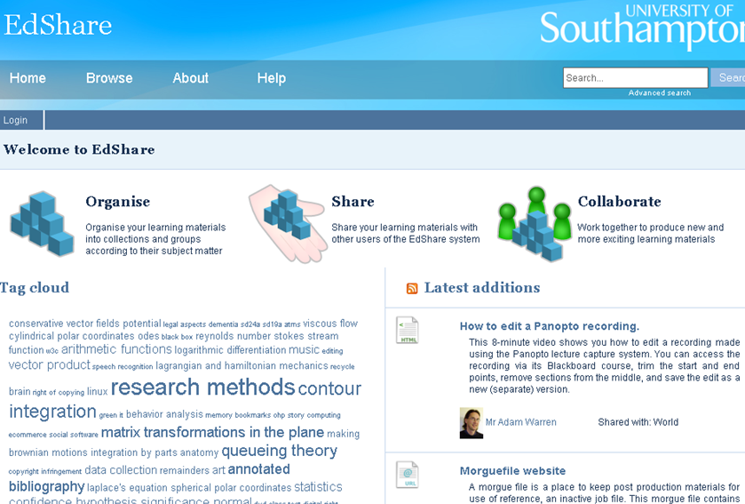
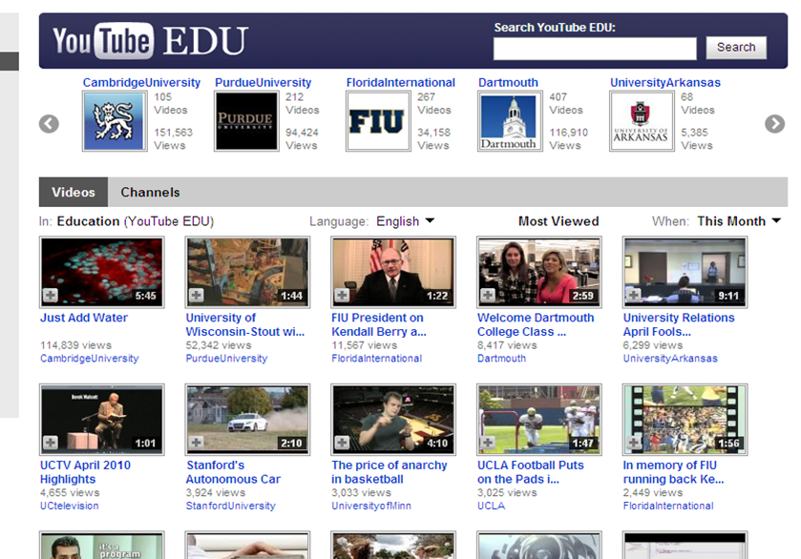

Slide 9
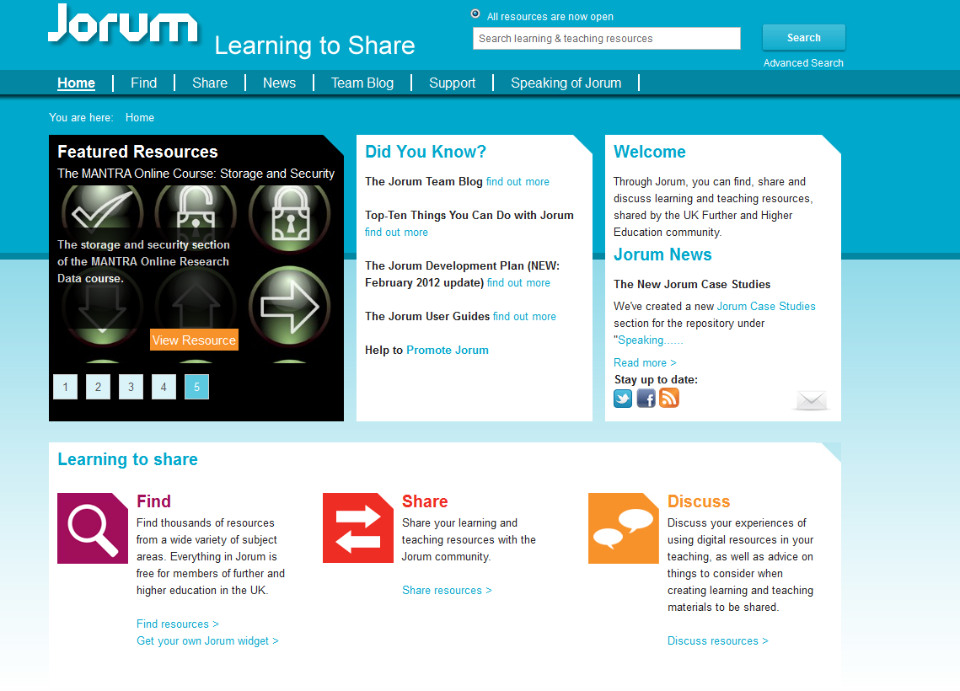

Slide 10
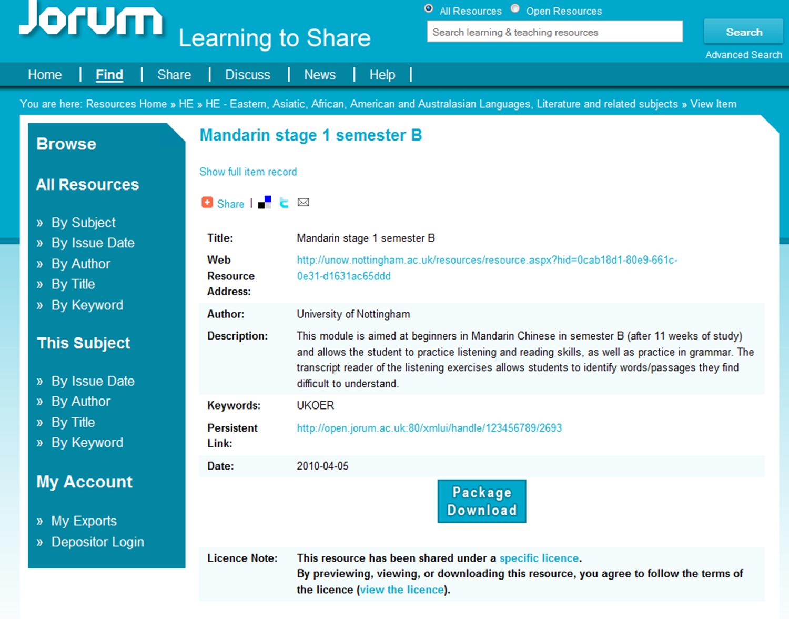

Slide 11
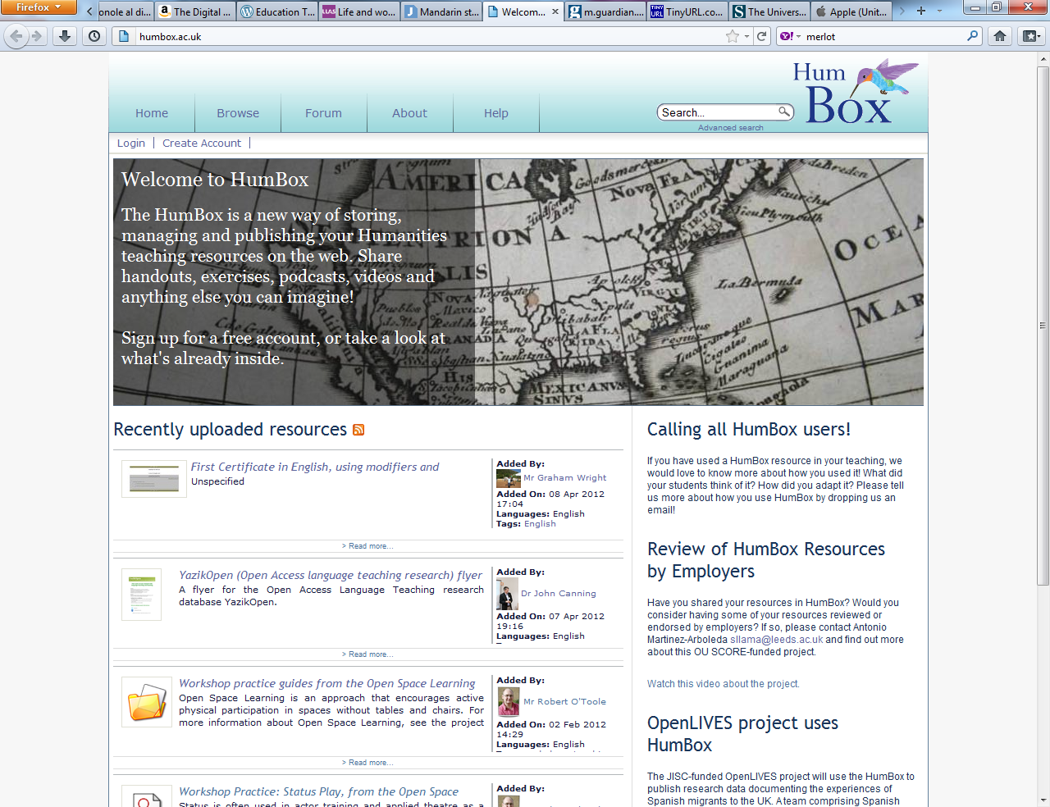

Slide 12
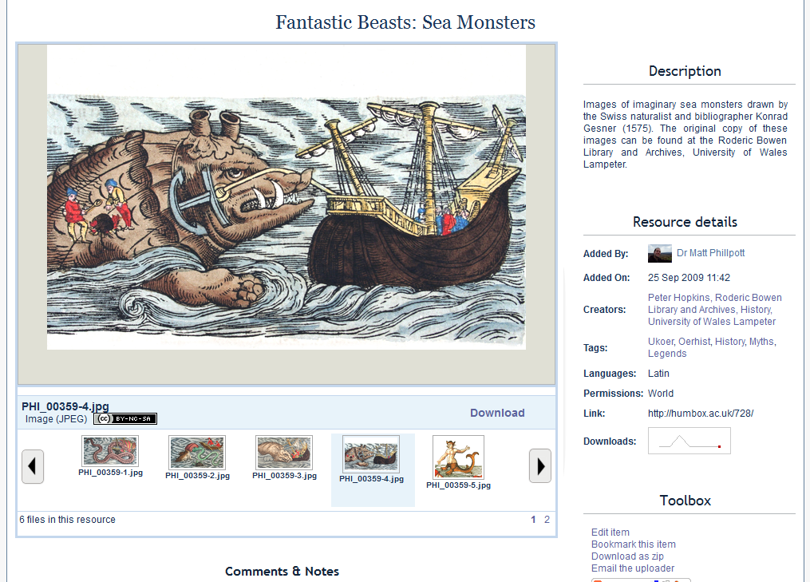
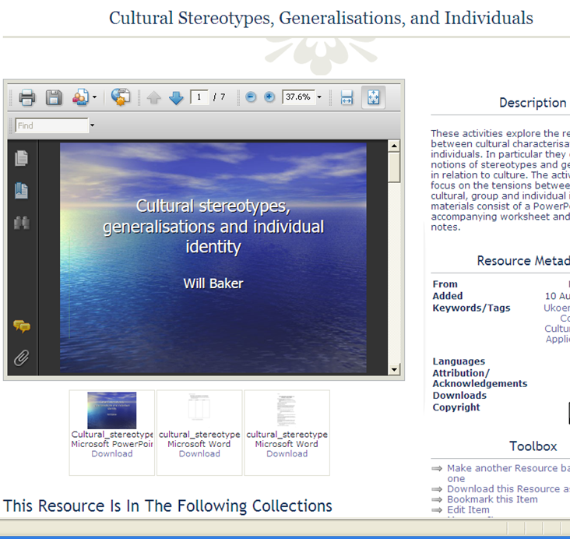
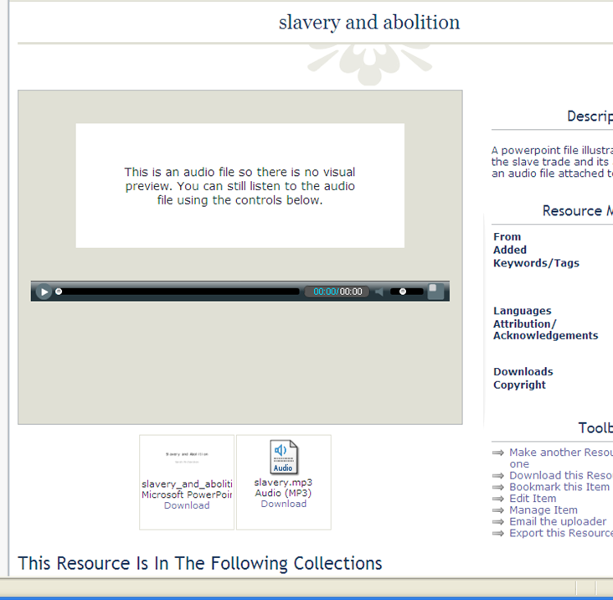

Slide 13
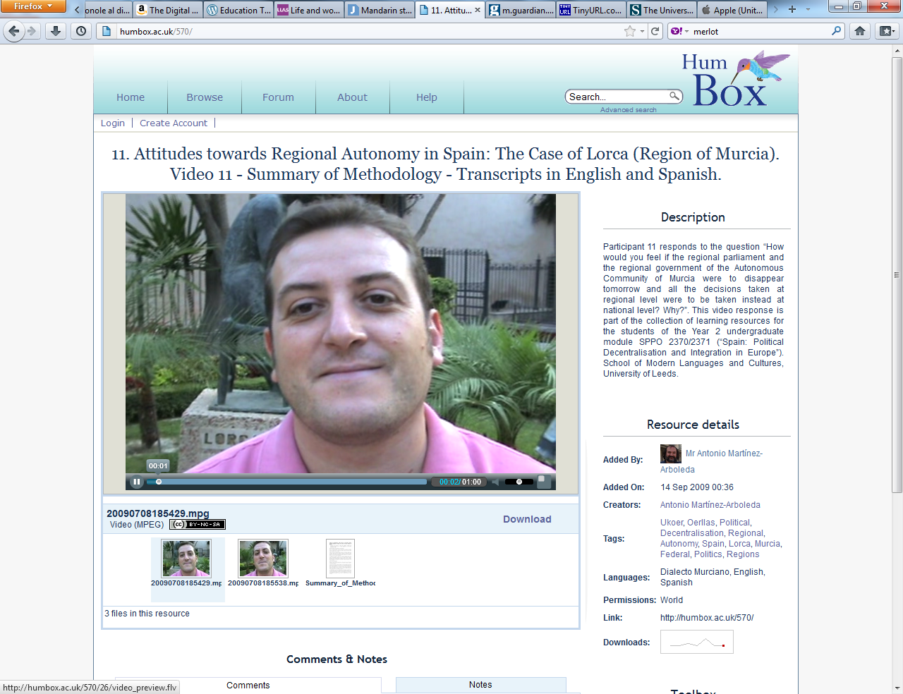

Slide 14
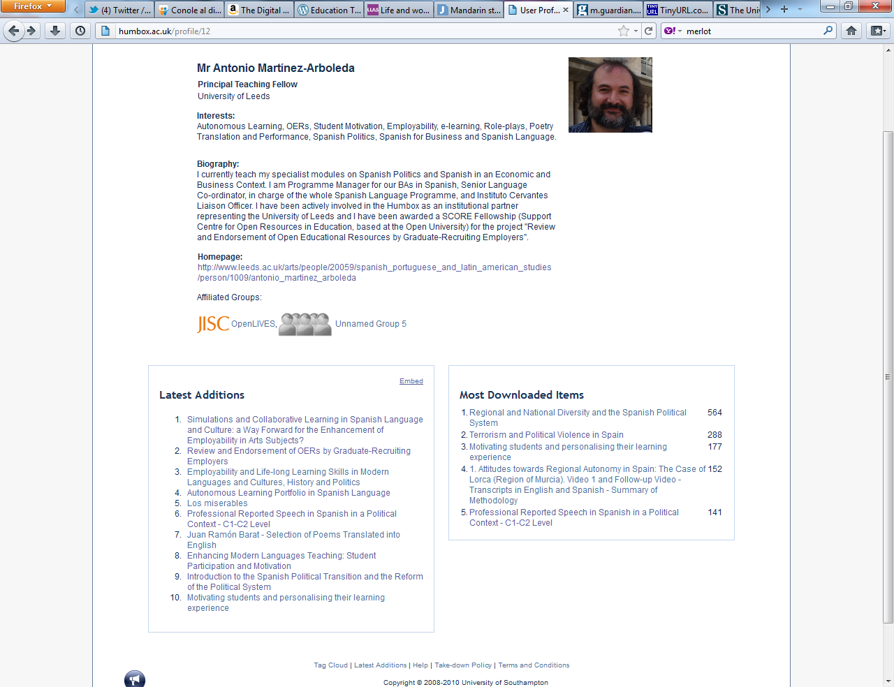

Slide 15
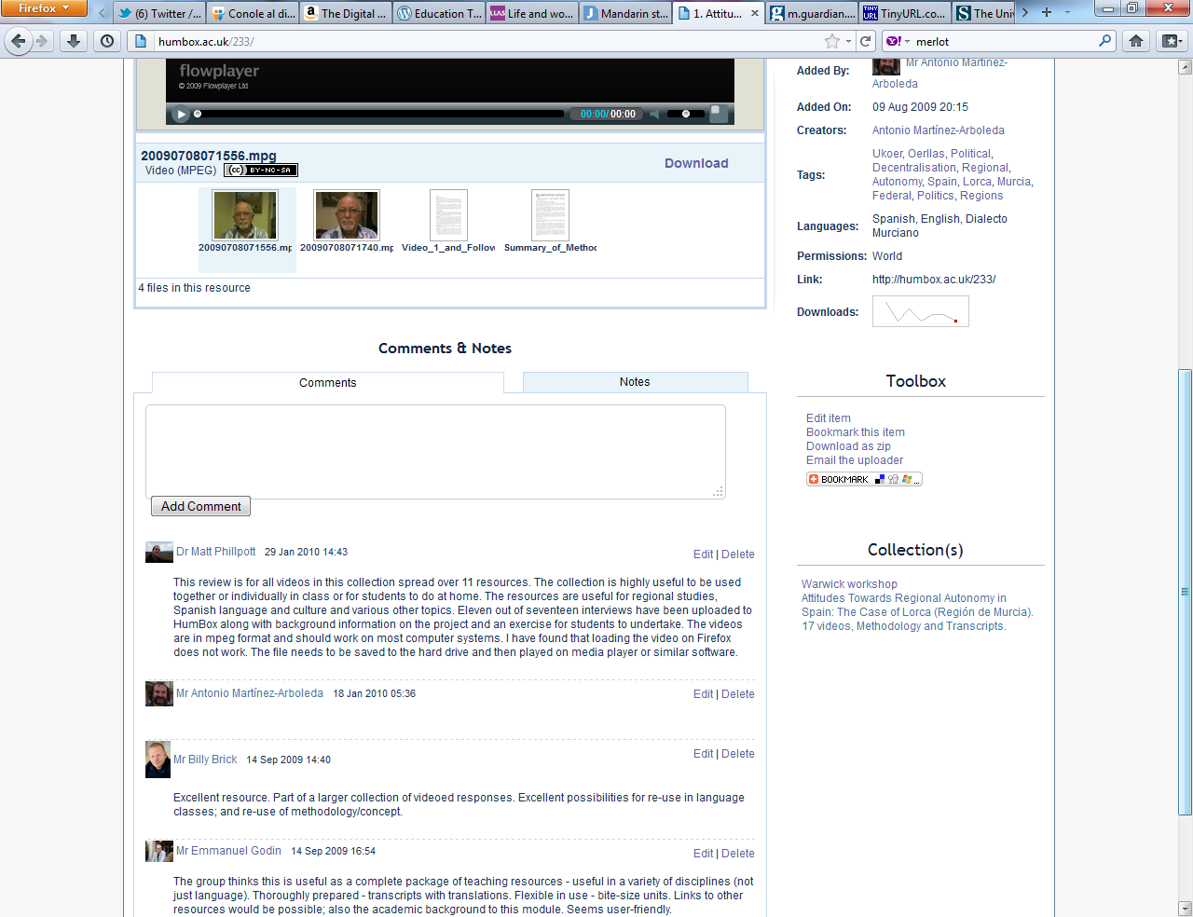

Slide 16
What about sharing your own materials?

Slide 17
Benefits of sharing
demonstrates excellence in teaching
way of showing impact for non-research staff
raises your profile
way of linking research and teaching
demonstrates excellence in content, technology or pedagogy
a way of making connections in discipline community
a way of making contact with other audiences for your work
encourages collaborative working

Slide 18
Reasons for using HumBox
see what other practitioners/institutions are doing
to share practice and get reviews
can find useful resources to adapt
helps to reflect on own practice
provides good ideas to improve/enhance practice
good way to keep up with developments in the discipline
early career researchers can showcase work and teaching experience
can see perspectives from other hums disciplines

Slide 19
How do I get started?
Download from various sites to get a feel for the material and the repository
Dip your toe in first
You don’t have to share everything
Don’t worry about material having to be ‘perfect’
Make use of all the online help out there on IPR/copyright, processes for sharing
Find out if your institution has a repository, iTunesU site and any guidance for engaging with OER

Slide 20
Useful links for info and advice (OERs)
OER Infokit: http://bit.ly/oerinfokit
The JISC (funding, OER projects): www.jisc.ac.uk
Open Courseware Consortium: www.ocwconsortium.org
Some repositories:
Jorum: www.jorum.ac.uk
HumBox: www.humbox.ac.uk
LanguageBox: http://languagebox.ac.uk
LORO (Language Open Resources Online): http://loro.open.ac.uk/

Slide 21
Some tips for authoring online activities…
Find out what software your institution has already bought and get training in it
Find out how to get best use out of your VLE
Always start with your teaching purpose and then decide which tool/software may work best for you – it may not be a technical solution!
Plan on paper and consider how, when and where students will interact with your material

Slide 22
…and some tools
Authoring tools:
Exercise generators: Hot Potatoes
Learning object creators: (LOC, Xerte, GloMaker2)
Course production: (WimbaCreate)
Audio/video recordings: (vocaroo, Audacity, eyejot, mailvu)
Screen capture: (Camtasia)
Cool tools: (MyBrainshark, Toondoo)

Slide 23
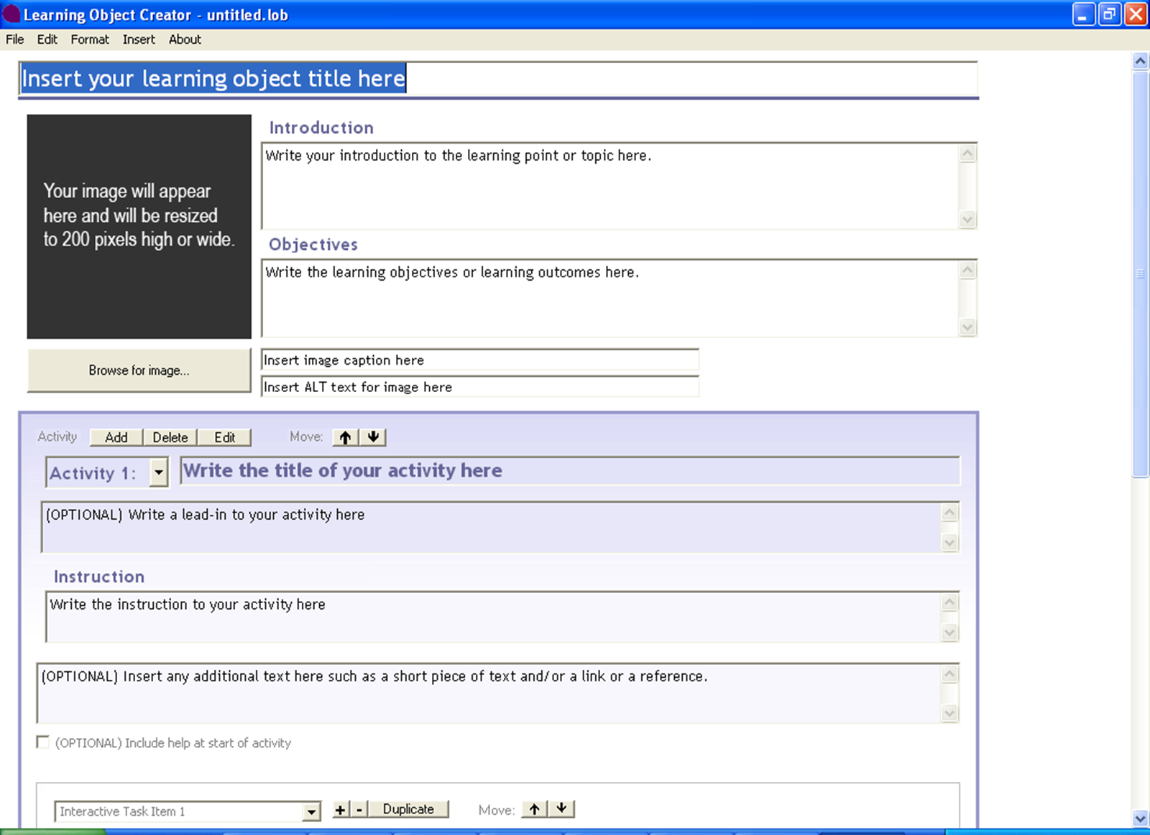

Slide 24
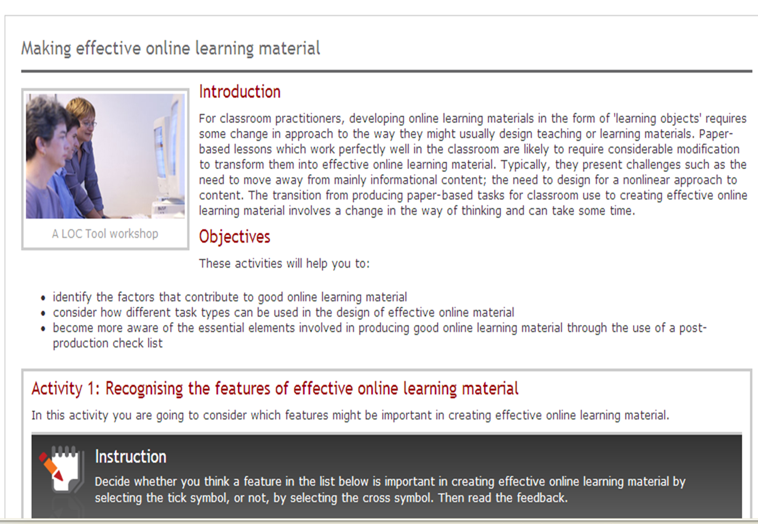

Slide 25
Use LLAS to help you create and share
HumBox and Language Box: store and manage your own resources, access other peoples’ material, create collections online for students to use.
LOC tool: simple authoring tool with a conscious pedagogic approach
Attend or present at our annual elearning symposium
Workshops and conferences
Ask our advice, help or collaboration with your events or funding bids

Slide 26
Some useful links and references
Online:
Using social networking sites and other technology – useful tips from a language teacher http://www.iltl.wordpress.com
Blogpost on trends in educational technology: http://learn231.wordpress.com/2011/10/25/trend-report-1/
Guardian Story about Stanford University’s AI course: http://tinyurl.com/cp76drx
LLAS elearning symposium past presentations (recent topics: use of Twitter; Facebook and social networking sites in education; tandem learning; apps, wikis): http://www.llas.ac.uk/events/archive/6395
Database of open access research into teaching MFL http://yazikopen.org.uk/yazikopen
Books:
‘Rethinking Learning for a digital age’ (2010) by Rhona Sharpe, Sara de Freitas, Helen Beetham. Routledge.
‘The Digital Scholar’ (2011) by Martin Weller. Bloomsbury.

