Slide 1

Piloting Employer Engagement in OERs Repositories: A new approach to curricular employability in HE
Antonio Martínez-Arboleda
Principal Teaching Fellow - SCORE Fellow
University of Leeds – Open University
Employer Engagement in a Digital Age. 4 July 2012. University of Greenwich. apt2012

Slide 2
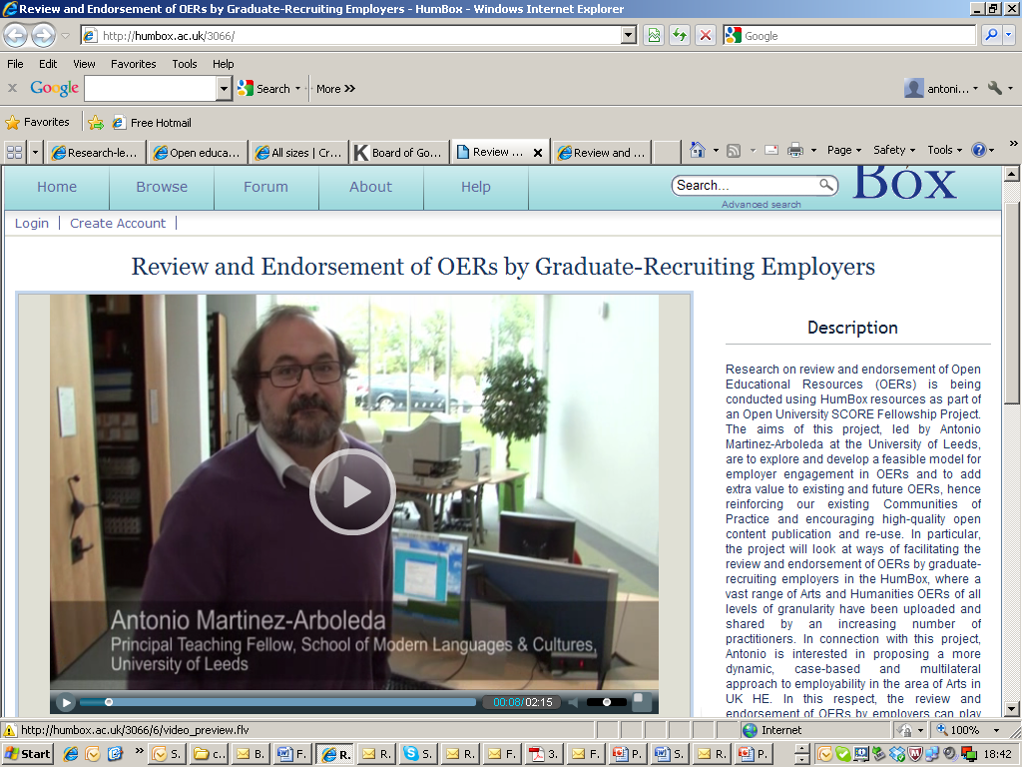

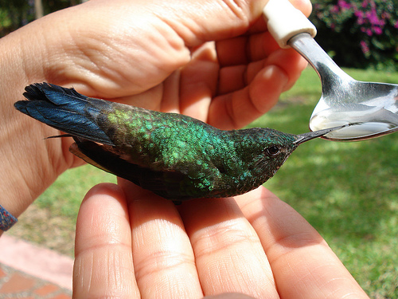
The SCORE-funded project

Slide 3
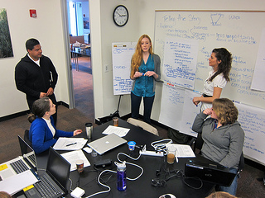

Curricular Employability and Digital Engagement
Response by Institutions and Academics
Demands for Employability
Open and Public Engagement through OER
No channels for engagement
Dynamic, decentralised, case-based, multilateral and collaborative approach to employability in Arts and Humanities.

Slide 4

Testing the hypotheses with academics
Critical discussion around the question of employer engagement in OER through review and endorsement in HumBox
Primary data obtained from interviews to academic users of HumBox
Showcasing good practice
Educational value of engagement
OERs and OERs repositories as tools and channels for articulating the relationship between employers and academics
The HumBox allows non-educational users to create “collections” made up of other users’ resources and have a comment box for each resource

Slide 5
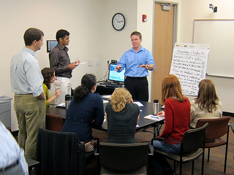
Research with employers
1. Information on OERs and Project
2. Questions on curricular employability, contribution to HE, and involvement in OERs.
3. Resources reviewed.
4. Interview reflecting about the actual reviewing experience, the resources themselves, the possibility of publishing the resource, possible future engagement with OERs publishers and repositories.
5. Publication of reviews

Slide 6

Some of the findings
Employable skills (life skills) in curriculum can be the subject of educationally fruitful discussion between Academics and Graduate Recruiters.
The underlying relationship between Recruiters and Career Services is pivotal in that digital partnership
OER Reviewing and Endorsement in repositories can be the tool but there is a variety of channels
“Blended engagement” vs 100% Digital engagement

Slide 7



Reflections: the symbiotic partnership

Slide 8

Reflections: the synergetic partnership

Slide 9

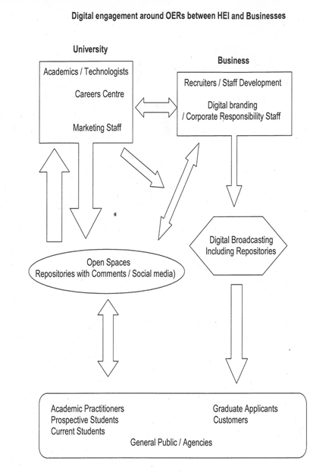

Reflections: the complex partnership

Slide 10
Thanks and Attributions
Thanks to Carl Gilleard, CEO of the Association of Graduate Recruiters (AGR), Bob Gilworth, Director of the Careers Centre of the University of Leeds, Kate Borthwick, HumBox programme manager (University of Southampton), all the academics and recruiters who participated in this research and SCORE for supporting funding this project.
Reference to First part of this SCORE Fellowship: Martínez-Arboleda A. (2012) ‘Review and endorsement of OER by graduate recruiting employers in the HumBox repository: the educational case in HE Arts and Humanities subjects’ Proceedings of Cambridge 2012: Innovation and Impact – Openly Collaborating to Enhance Education, OCW Consortium and SCORE, Cambridge, UK, April 16–18 2012, Milton Keynes, The Open University, pp. 336-345, http://oro.open.ac.uk/33640/ (accessed 30 june 2012), ISBN978-0-7492-2937-5 [ebook].
All pictures from Flickr.com CC BY SA
-Chris Willis (Close-up Bee)
-Abhishek Sundaram (Salesman)
-Alaska_Dude (people in street show)
-fancyadiamon (diamond)
-Kevinn Doole (people in meetings) 2 pictures
-DoraExplorer1 (crystal ball man)
-vancouverfilmschool (students in front pcs)
-denver university (students in café area)
-daneel ariantho (molecule)
-Ell r brown (cannals network)
-Luis perez (colibri bird)
Antonio Martínez-Arboleda 2012

