Slide 1
Public Engagement
John Canning
PGR Training

Slide 2
What is Public engagement (PE)?
Public engagement describes the myriad of ways in which the activity and benefits of higher education and research can be shared with the public. Engagement is by definition a two-way process, involving interaction and listening, with the goal of generating mutual benefit.
National Coordinating Centre for Public Engagement
http://www.publicengagement.ac.uk/

Slide 3
Why engage with the public?
Ethical responsibility
Tax payers’ money
Prestige/ fame
Giving something back
Causes/ activism
Research Evaluation Framework (REF) Emphasis on public engagement/ impact
Education
Knowledge transfer

Slide 4
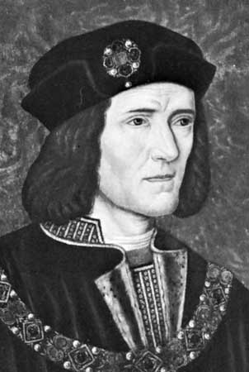
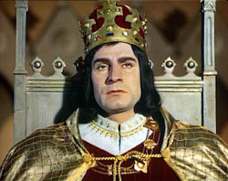
Richard III

Slide 5
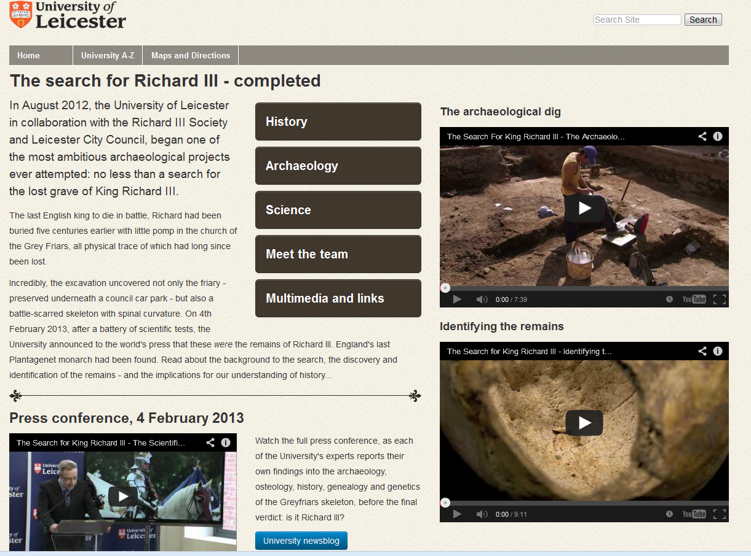

Slide 6

King in the car park

Slide 7
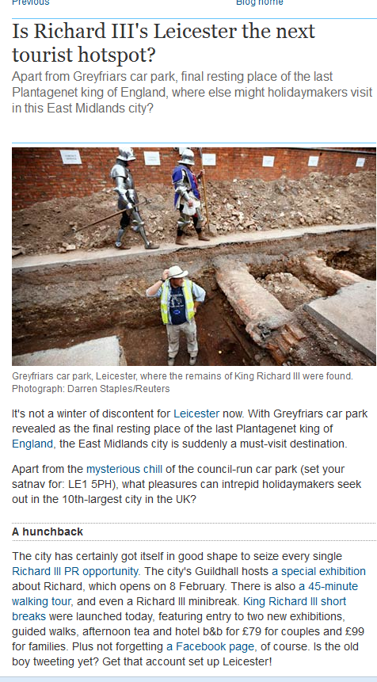
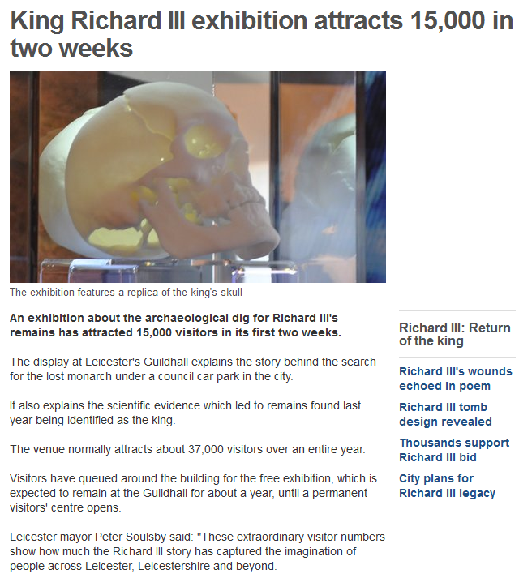
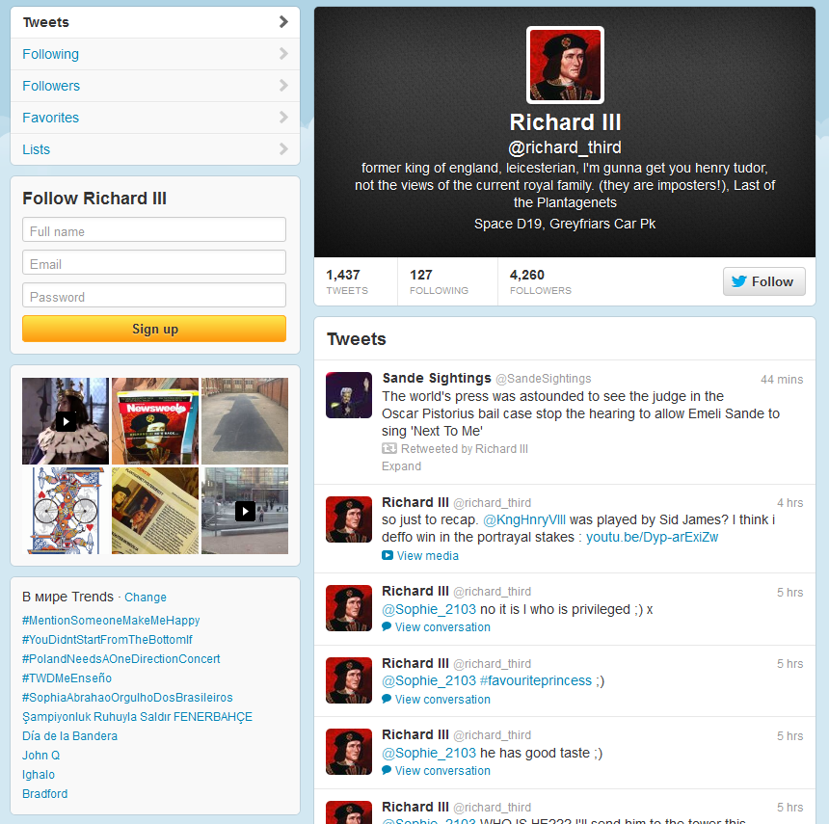
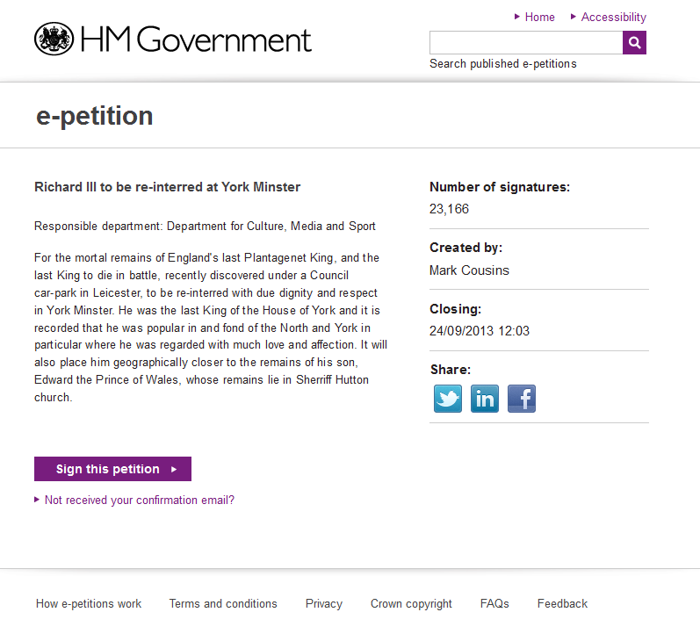
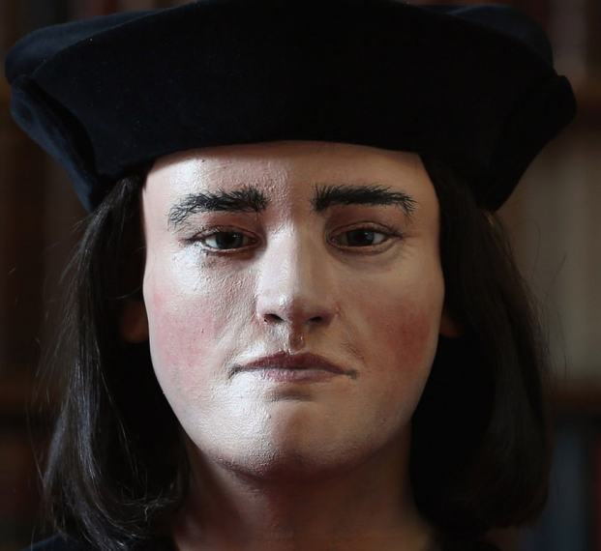

Slide 8
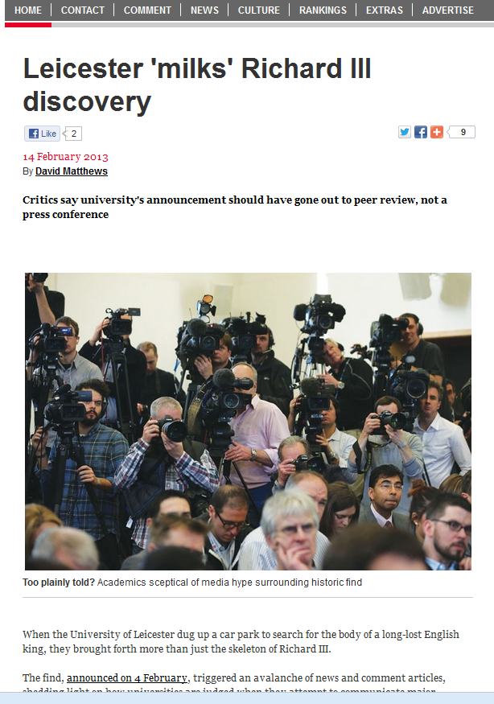

Slide 9
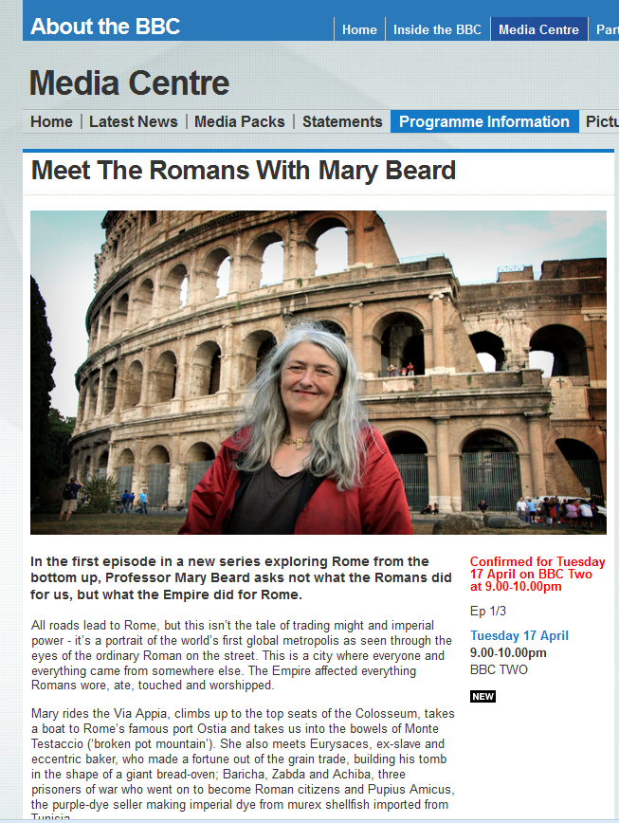
Mary Beard, Classicist

Slide 10
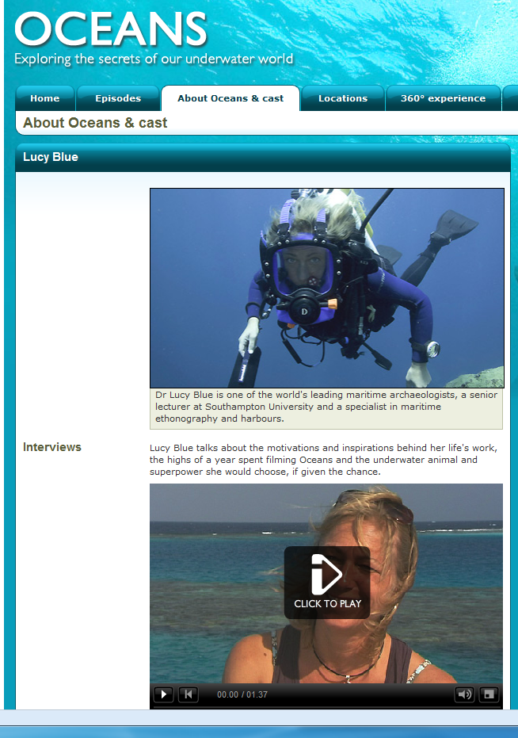
Lucy Blue, archaeology

Slide 11
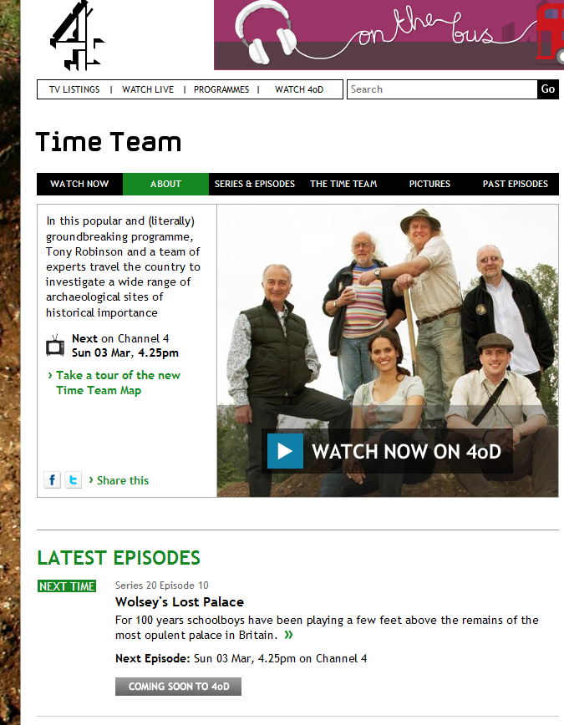
Time team

Slide 12
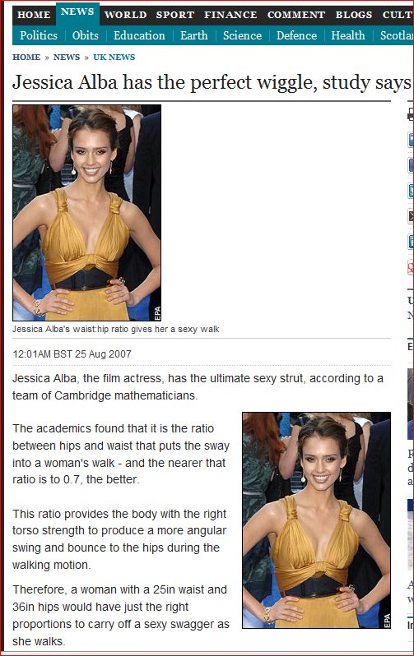
Jessica Alba has the sexiest wiggle study says. Telegraph, 25 August 2007
Jessica Alba, the film actress has the ultimate sexy strut according to a team of Cambridge mathematicians

Slide 13
The sexiest walk
“We are conducting a survey into the celebrity top ten sexiest walks for my client Veet (hair removal cream) and we would like to back up our survey with an equation from an expert to work out which celebrity has the sexiest walk, with theory behind it. We would like help from a doctor of psychology or someone similar who can come up with equations to back up our findings, as we feel that having an expert comment and an equation will give the story more weight.”
Goldacre, Ben (2008-12-07). Bad Science (pp. 231-232). Harper Collins, Inc.. Kindle Edition.

Slide 14
The Clarion press release was not approved by me and is factually incorrect and misleading in suggesting there has been any serious attempt to do serious mathematics here. No ‘team of Cambridge mathematicians’ has been involved. Clarion asked me to help by analysing survey data from eight hundred men in which they were asked to rank ten celebrities for ‘sexiness of walk’. And Jessica Alba did not come top. She came seventh.
Quote from Professor Richard Weber IN: Goldacre, Ben (2008-12-07). Bad Science (p. 232). Harper Collins, Inc.. Kindle Edition.

Slide 15
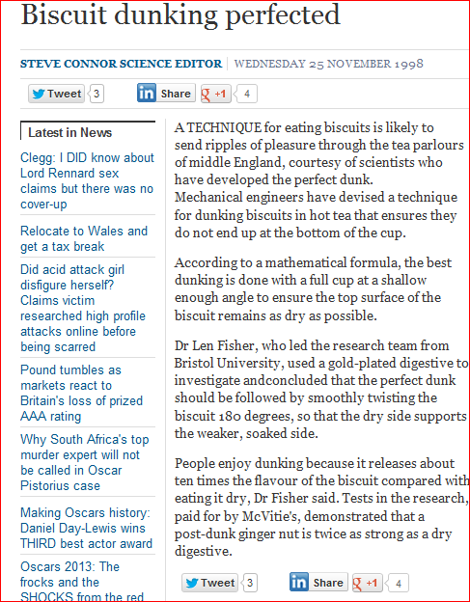
Biscuit dunking science

Slide 16
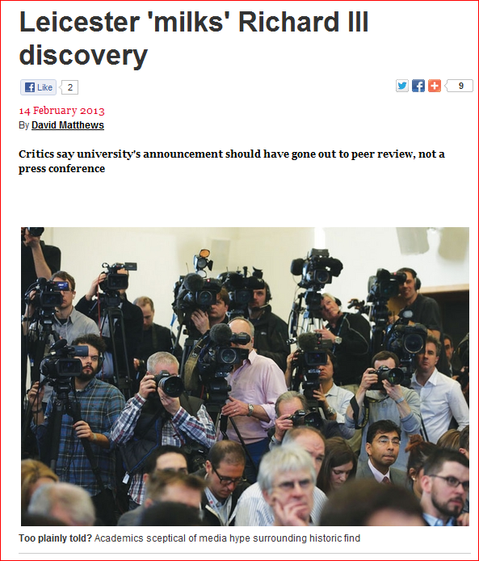
Leicester ‘milks’ Richard III discovery

Slide 17
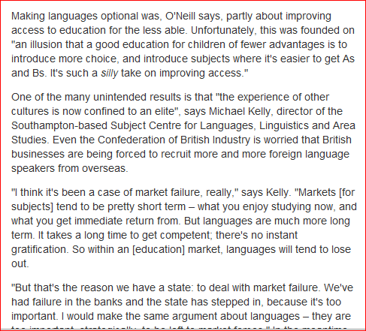
Who still wants to learn languages?
The Guardian, Tuesday 24 August 2010

Slide 18
Horse meat scandal: 'food prices have to go up', says former Tesco executive, Telegraph, 13 February 2013
…
Her opinion was echoed by Dr Emma Roe, a lecturer in Human Geography at University of Southampton, who claimed it was 'no surprise' that the contamination had been found in value brands.
"The horse meat saga suggests that there is a shortage of beef products at a price suitable for value-range processed meat products.
"The retailers are pushing down prices to meet the needs of cash-strapped consumers who are dealing with food and fuel bills prices rising."

Slide 19
Open lives project
“…digitise research resources documenting the migration experiences of Spanish emigrés. Once released as open content, this raw research data will be developed as open educational resources for a range of teaching and learning contexts in humanities and social sciences on topics such as migration, life history, employability skills, research skills, language learning. The project will use a tested process model for sharing expertise and teaching ideas to create reusable and innovative teaching resources
Website: http://openlives.wordpress.com/
TV coverage- Meridian TV

Slide 20
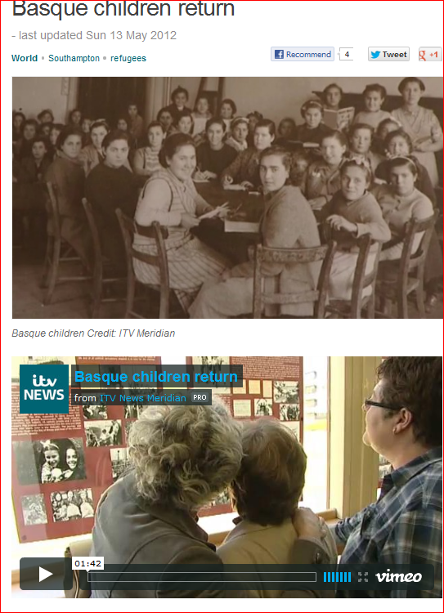

Slide 21
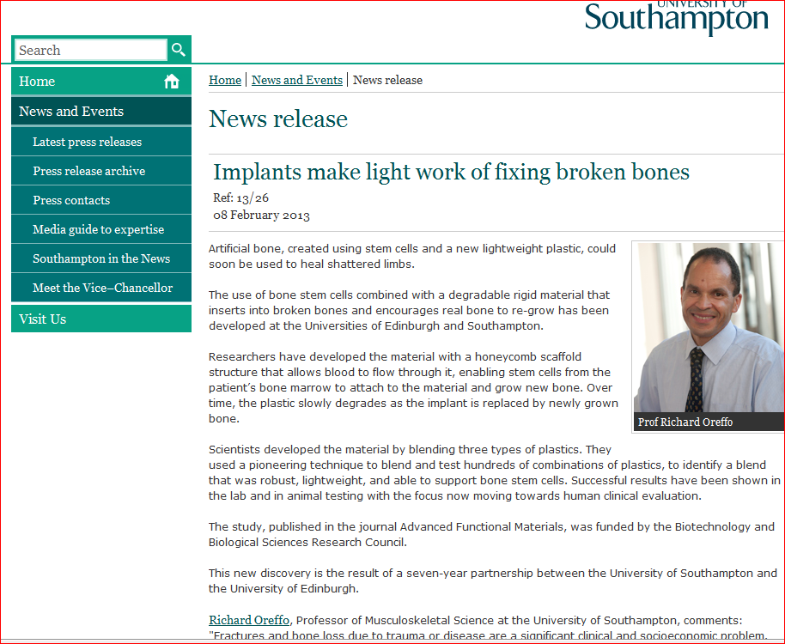

Slide 22
“Cam Shafted”, Sunday People, 18 March 2012
…
A study by Sheffield University professor Danny Dorling warned of worsening gaps in house prices and education, while nine out of 10 of Britain’s jobless blackspots are in the northern half of the country.
And a study by Manchester University found the life expectancy gap was at a 40-year high – with 37,000 more people a year dying early in the North.

Slide 23
Places of engagement
Media interviews
Newspaper/ magazine articles
Open days
Involvement with special interest groups/ charities
Continuing professional development
MOOCs
Consultancy for public, private or charity

Slide 24
Public engagement places
School visits
TV appearances
Self-made films , e.g. youtube
Social media e.g. twitter
Websites/ blogs
Conferences
Public talks

Slide 25
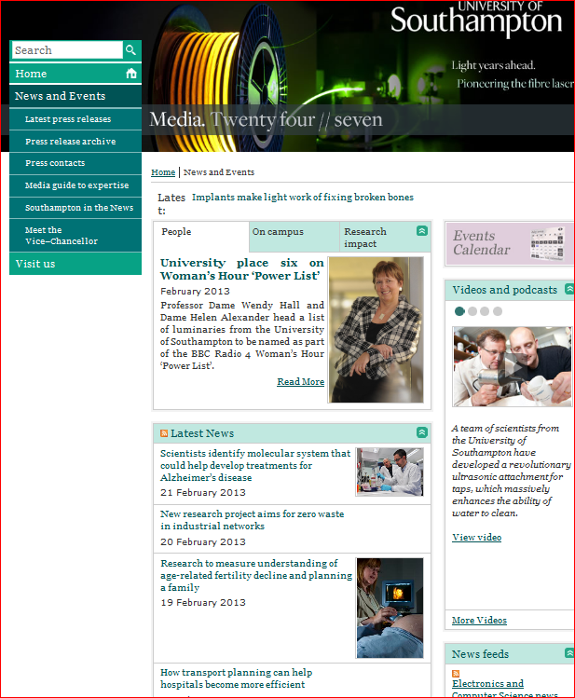
http://www.southampton.ac.uk/mediacentre/

Slide 26
Poster for postgraduate humanities conference with public engagement emphasis
Poster design https://connect.le.ac.uk/posters
A1 or A0 size
300-500 works plus visuals
Not a big version of a paper. I’ve bought some examples in:

Slide 27
Software
Powerpoint
MS publisher
LaTeX

Slide 28
Activity
Take a piece of A3 paper and plan a poster.

