Slide 1
Languages for Sustainability: Why We Must Take the Opportunities
John Canning, LLAS Centre for Languages, Linguistics and Area Studies, University of Southampton
Innovative Language Teaching and Learning at University: Enhancing the Learning Experience through Student Engagement, 28th June 2013
@johngcanning

Slide 2
GCSE results Day 1992
Preparing for the PhD viva, 2002
All getting easier
Former education minister Sir Rhodes Boyson (1925-2012) on BBC news

Slide 3
Things to embed in your teaching
Employability
Key skills
Entrepreneurship
Commercial awareness
Critical thinking
Sustainable development
Study skills
Citizenship
Ethics
Intercultural competence
Numeracy
Social responsibility
Plus many more…

Slide 4
Competent men
Sherlock Holmes
Jeeves

Slide 5
Angus MacGyver (US TV character)
Knowledge of English, French, German, Russian, Italian and American Sign Language.
Fly a plane, pilot a helicopter, ride a jet ski, pick a lock, , defuse a bomb,
play the guitar, defeat bad guys with his bare hands, negotiate peace.
Can get out of tricky situations by combining his quick thinking skills with his equipment (a Swiss army knife, roll of duct tape, paper clip and whatever else he can scavenge from his surroundings).
Volunteers for charity
Visits his Grandad

Slide 6
Lampooned on The Simpsons
Man: Thank you, Senor MacGyver, for saving our village.
MacGyver: Don't thank me, thank the Moon's gravitational pull.
Selma: That MacGyver's a genius.
Sideshow Bob: First of all, he's not a genius, he's an actor, and second, he's not *much* of an actor.
Selma: You're lying! You're lying!
Sideshow Bob: No Selma, this is lying: that was a well-plotted piece of nonclaptrap that never made me want to retch.

Slide 7
What should every graduate know?*
1. Basic probability and statistics.
2. Basic social psychology principles, enough not to get suckered by con artists and manipulative politicians.
3. Basic micro and macro economics
4. Basic understanding of American government
55. Understanding of the scientific method, error and uncertainty.
6. Elvis Costello.
7. How credit works, how to make a budget, and basic financial planning skills.
8. Where food actually comes from and how to get it yourself.
*Chronicle of Higher Education forums, 2013 www.chronicle.com

Slide 8
9. A course in Decision Theory, covering:
- Some elementary game theory
- Learn about heuristics and biases.
- How is the mind tricked into making certain decisions?
- Do we have inherent preferences, or are they constructed as we face choices?
- What are loss aversion and probability weighting? i.e. why do people buy both insurance and lottery tickets?
10. Etiquette.
11. Pass the test to grant citizenship to foreign nationals
12. be able to read and understand a semi-literate news magazine cover to cover (i.e. Time; Newsweek)
13. Understand the basics of world geography
14. Change tyres and oil on car
15. Basic first aid.
16. Basic chemistry (not be taken in by claims about water and skin creams).

Slide 9
And
17. Learn another language

Slide 10
1950s and 1960s
Not total prosperity for all, but university education offered.
Free university tuition with maintenance grants
Increased life expectancy
Final salary pensions
Low house price to income ratios
Universal benefits at 60 plus. E.g. bus passes
Early retirement
Parents and grandparents of today’s 18-25 year old students.
Intergeneration conflict becoming more important than class conflict??????????

Slide 11
“Never had it so good”.
You will see a state of prosperity such as we have never had in my lifetime - nor indeed in the history of this country. Indeed let us be frank about it - most of our people have never had it so good. – Prime Minister Harold MacMillian speaking in 1957.
Post-War economic boom, growth in car ownership. Extensive house building. Higher wages, Increased production.

Slide 12
Challenges for present and future generations
Affordability of housing
Lower wages
Unpaid and paid-for internships
Pension uncertainty
Aging/ growing population
Graduate unemployment and underemployment

Slide 13
Graduate/ non-Graduate social/ economic divide.
Public spending cuts
Climate change
Living sustainability
Global poverty
AIDS

Slide 14
Time for difficult questions:
What do our language students need to know for their future lives?
Does our curriculum equip students with what they need?
What is the role of the individual teacher?
Whose responsibility is it? Teacher? Student? University? Government? Other?
How so we make our students responsible to future generations?

Slide 15
One way to go
More of the same
  Traditional disciplinary concerns…
  That’s not my job…
  Sounds very interesting but…
  Research into X is where it is at…
  Not part of what we do…
  The students aren’t as good as they used to be…
  I don’t know anything about economics, business, marketing, environmental science
  Nobody listens to me anyway.

Slide 16
Another way to go
Innovation and change
  Let’s make this our concern
  I don’t know about ‘X’ but I’ll learn
  I have an ethical duty to future generations
  How can we fix this problem?
  What can I/ my students contribute?
  These other people have it wrong. I must help them.

Slide 17
A big challenge
Increase global temperatures
Rising sea levels
Coastal erosion
Declining biodiversity
Climate change migration
Increasing global population
AIDS epidemic
  Lets make these concerns for languages.

Slide 18
Global and local sustainability
Interdisciplinary module available to all Southampton students
BUT majority of students Environmental Science, geography and related.

Slide 19
Module aims
1. To explore the range of contested definitions of sustainable development.
2. To apply sustainable development in the context of the home academic discipline of all students and relate to other areas of study.
3. To investigate the relationship between the range of stakeholders involved in the application of sustainable development in local, national and global policy.
4. To explore how different academic disciplines can contribute to the goal of sustainable development.
5. To demonstrate the diverse range of leading sustainability research taking place across the University of Southampton.
6. To develop an agreed set of Sustainable Development Goals through participation in a Student Sustainable Development Summit.
7. To apply emerging multimedia and social networking techniques in the development and distribution of a series of sustainability films
8. To produce a set of Sustainability Conference Season Proceedings.

Slide 20
Languages content
Case studies approach
Capel Celyn, Wales. Reservoir
James Bay, Quebec. Hydro-Electric Dam

Slide 21
Capel Ceyln
1 August 1957: Liverpool Corporation Act: Submergence of Capel Celyn near Bala to supply water to Liverpool.
Reservoir completed 1965
35/36 Welsh MP’s opposed the bill (one did not vote)
2005: Official apology from Liverpool City Council

Slide 22
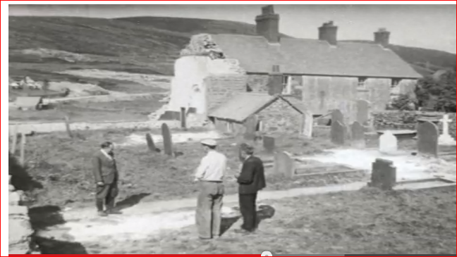

Slide 23
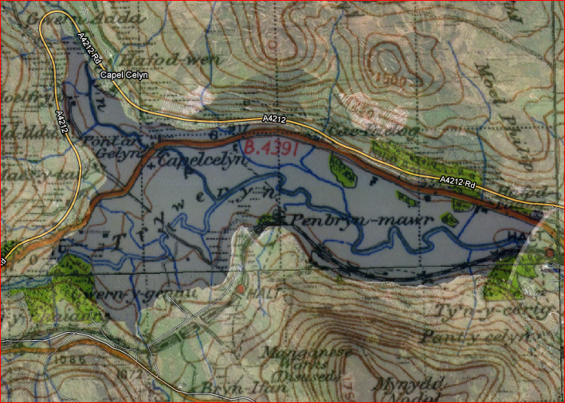
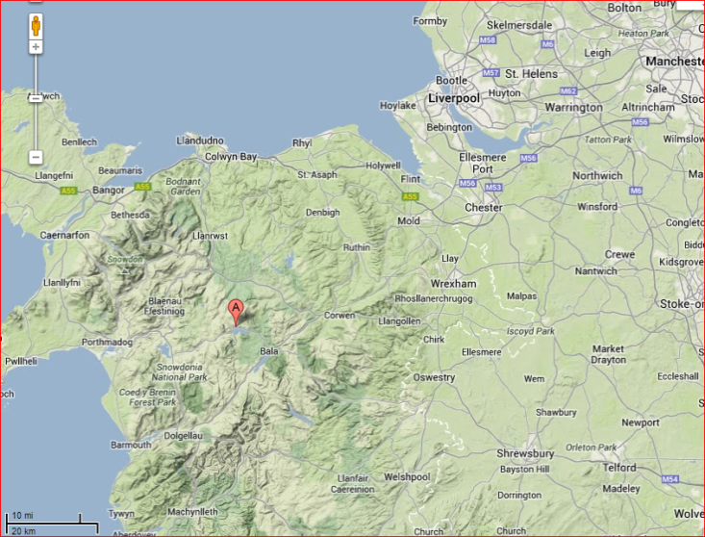
1 mile or 1.61km

Slide 24
Capel Celyn
Capel Celyn was about more than Capel Celyn.
Predominantly Welsh-speaking community at a time when numbers speaking the language were decreasing.
Illustrated that the politicians of Wales as a whole were powerless against the water needs of a large English city, even if they were all united.
People of the village had no power to stop their homes from being submerged under water.
One choice they did have was whether they wanted to dig up their relatives in the graveyard and bury them elsewhere.

Slide 25
James Bay, Quebec: Hydro-electric dam
Work started early 1970s work started on the James Bay hydro-electric project in the Canadian Province of Quebec. The dam lies over 1000km north of Montreal, the largest city in the Quebec.
Population of Quebec approx. 7 million
Territory three times the size of France
90% of whom live along the St Lawrence river, most within about 150km of the US border.
The Northern two-thirds of the Province are home to just 20,000 mostly Cree and Inuit native peoples.

Slide 26
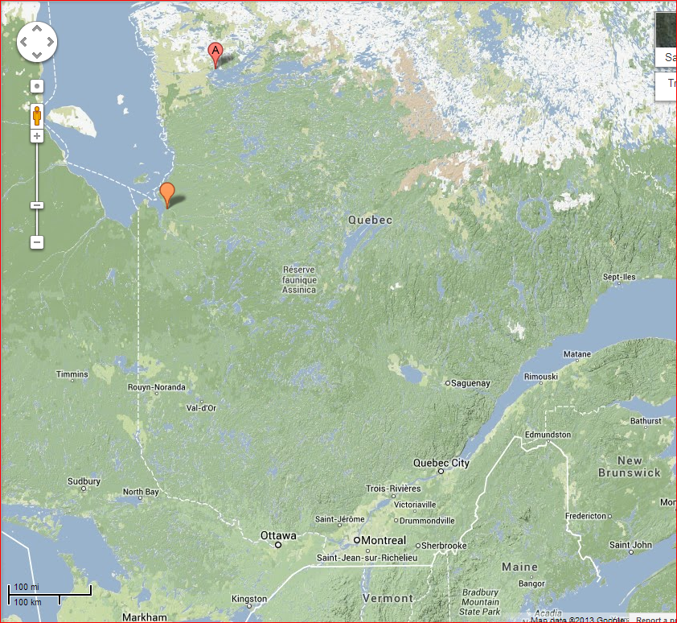
James Bay

Slide 27
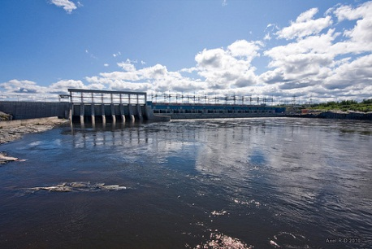
Axel Drainville http://tinyurl.com/plz6ybu

Slide 28
Socio-political and cultural context.
1960s Quebec went through a rapid period of modernisation and cultural change known as the “Quiet Revolution” or “La revolution tranquille”.
Increasing support for separatism from the Rest of Canada, a more assertive French language ‘Quebecois identity’
Desire for economic sovereignty – most industry in Quebec, energy included, dominated by English Canadian and US interests.
assertion of an increasingly confident Quebecois identity. It also enabled Quebec to have control of its own energy supply. (This was well illustrated during the North American blackout of August 2003).

Slide 29
Legal challenge
A legal challenge to the Project meant that work was unable to go ahead until a legal agreement was put into place between the Hydro Quebec (owned by the Quebec government) and local residents.
The James Bay and Northern Quebec Agreement, signed in 1975, the Native peoples agreed to surrender parts of their traditional lands to the Quebec government in return for financial compensation, paid into the three native development corporations.
There is still controversy about the extent of the environment impact but the building of the dams did impact upon traditional hunting routes and on access to James Bay itself.

Slide 30
Language threat and language death
The death of a language is the death of a language is ‘a serious loss of inherited knowledge’. David Crystal Language Death
Some of this knowledge may be about medicine, agriculture and sustainable living.
Displacing minority linguistic communities is one of the causes of language death and the effects are not always understood at the time.
But is the defence of a linguistic or cultural minority community more defensible than the loss of other communities?

Slide 31
Questions to ponder
What is lost when a language is threatened or dies out?
Is it ethically, morally, culturally ‘different’ if affected residents speak a different language to the people development is ‘for’?
Is it ethically, morally, culturally different if affected residents speak an endangered language.

Slide 32
Two equal principles
1. The first is that Quebec needs to use the resources of its territory, all its territory, for the benefit of all its people.
2. The second principle is that we must recognize the needs of the native peoples, the Crees and the Inuit, who have a different culture and a different way of life from those of other peoples of Quebec.
  John Ciaccia MLA , The James Bay and Northern Quebec Agreement,
Can these be principles be reconciled?

Slide 33
Other language possibilities
Translation and sustainability
Literature and sustainability.
  Brecht, Grass, poetry
Ecolinguistics
  Global warming
  Greenhouse effect
  Developments

Slide 34
More questions
What do language student miss if they don’t engage with sustainability?
What do other students miss when they study sustainability without languages?
If our ethical responsibilities are to future generations what does the languages curriculum look like?
Innovation: Good innovation, bad innovation, unnecessary innovation?

Slide 35
My conclusions
We have an ethical responsibility to future generations
Do what is important to future generations
Learn what you need /want to know
Teach languages and/or language content in other disciplines/ multidisciplinary context.
Bring students in, but go out yourself.
"Be the change you wish to see in the world." Gandhi

