Slide 1

Student choice: student voice
John Canning, LLAS Centre for Languages, Linguistics and Area Studies, School of Humanities, University of Southampton
Thriving in an uncertain world: a workshop for heads of depts & leaders in LLAS
13 September 2012
LLAS
Centre for Languages, Linguistics and Area Studies
University of Southampton
Southampton, SO17 1BJ
+44 (0) 23 8059 4814| @LLASCentre | www.llas.ac.uk

Slide 2
Choices
Government push provide information and advice to increase accountability and inform choice:
Hospitals
Schools
http://www.direct.gov.uk/
  Driving
  Keeping chickens
  Registering births and deaths

Slide 3
What information do students want?
Refrew et al (2010) Potential students value opinions of current students more that any other indicator.
National Student Survey (since 2005)
Key Information Set (from September 2012)

Slide 4
What do potential students want to know?
‘Very useful’ rank | Information item | % indicating that this information would be ‘very useful’
1 | Proportions of students at the university satisfied or very satisfied with the standard of teaching | 54.4%
2 | Proportions of students at the university satisfied or very satisfied with their course | 50.5%
3 | Proportion of students in employment in the first year after completing this course | 44.6%
4 | Professional bodies which recognise this course | 44.3%
5 | Proportions of students at the university satisfied or very satisfied with the support and guidance they received | 43.6%
Renfew et al (2010) Understanding the Information Needs of Users of Public Information About Higher Education.

Slide 5
How do students decide where to go? (Summarised by Maringe 2006)
3 models
Structural
  Class background, social capital (including parental influence)
  Age, disability, ethnicity
Rational
  Relative rates of return for certain choices
Personality and subject judgements

Slide 6
Maringe (2006) on university choice
Case study of sixth formers in Hampshire
Price elements most important
  Availability of part-time work
  Avoid London
  Preference for North of England
Overall reputation is critical
Promotion, prospectus, people, least important factors

Slide 7
Subject choice (Maringe, 2006)
Most important:
  Job opportunities plus assessed performance
Advice of parents, teachers, careers advisors more important to girls than boys (Modern Languages ≈ 75% female)

Slide 8
5 behavioural steps towards university choice Maringe (2006)
Pre-search (register of interest in HE)
Search
  Institutions shortlisted already
  NB: Information/ data used at this point
Application
Choice/ decision
Registration

Slide 9
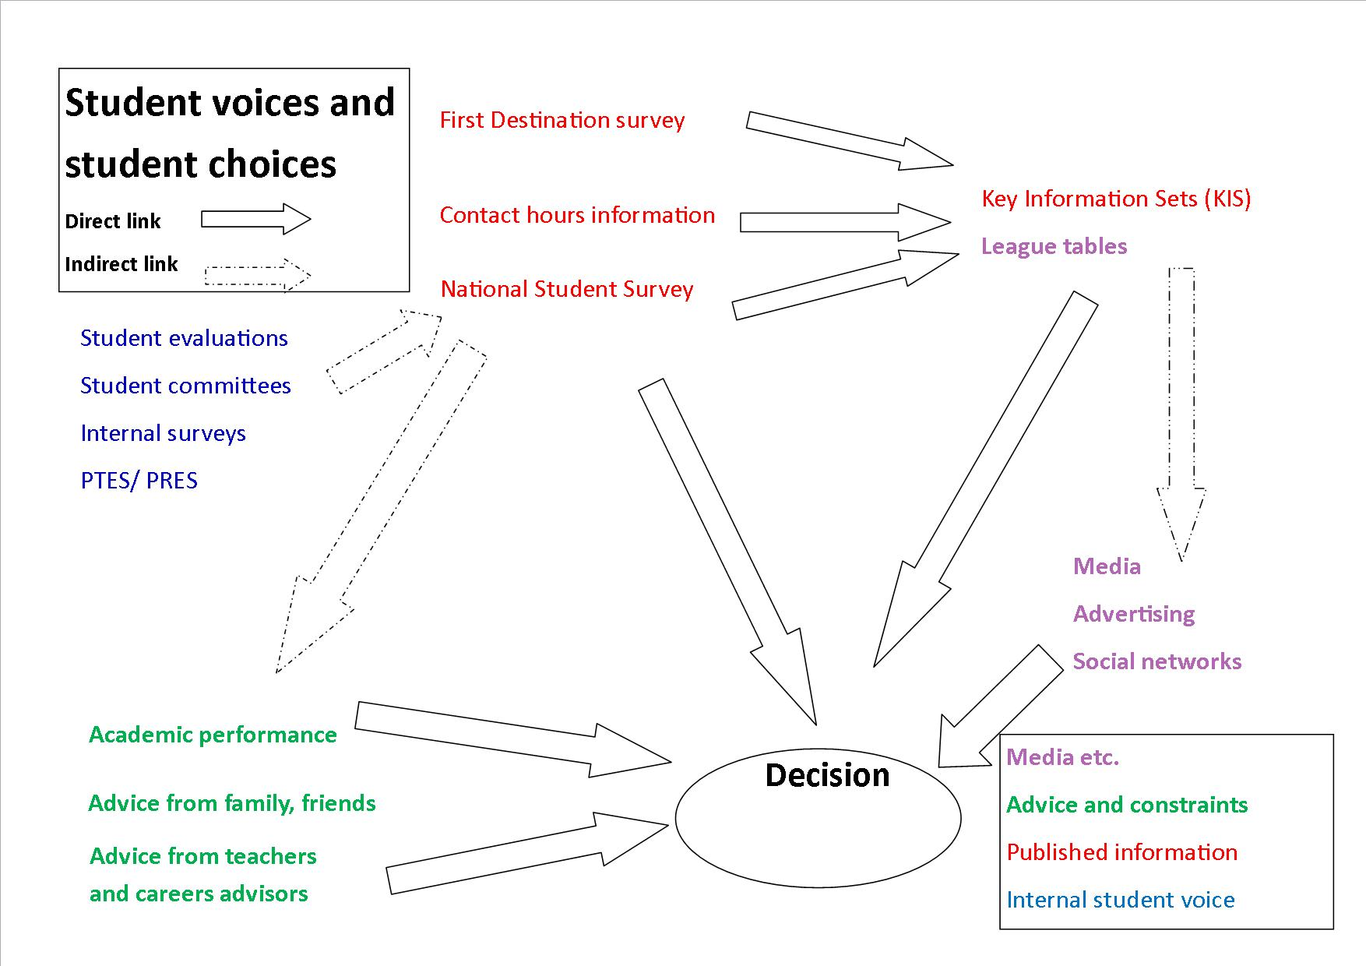

Slide 10
References
Maringe, F. (2006) ‘University and Course Choice: Implications for Positioning, Recruitment and Marketing’. International Journal of Educational Management 20: 466–479.
Renfrew, K, et al. (2010) Understanding the Information Needs of Users of Public Information About Higher Education. Manchester: Oakleigh. Available from: http://www.hefce.ac.uk/media/hefce/content/pubs/2010/rd1210/rd12_10b.pdf
See also reading list in pack

Slide 11
Contact
LLAS Centre for Languages, Linguistics and Area Studies
University of Southampton
Highfield
Southampton
SO17 1BJ
j.canning@soton.ac.uk
023 8059 7526
www.llas.ac.uk

