Slide 1
EUROCALL 2014, Groningen, The Netherlands
Linking CALL and SLA:
Using the IRIS database to locate research instruments
Zöe Handley & Emma Marsden
University of York
www.iris-database.org

Slide 2
Aims of CALL research
CALL research should aim to construct a reliable evidence-base with ‘engineering power’ which can be translated into designs for future CALL software and activities

Slide 3
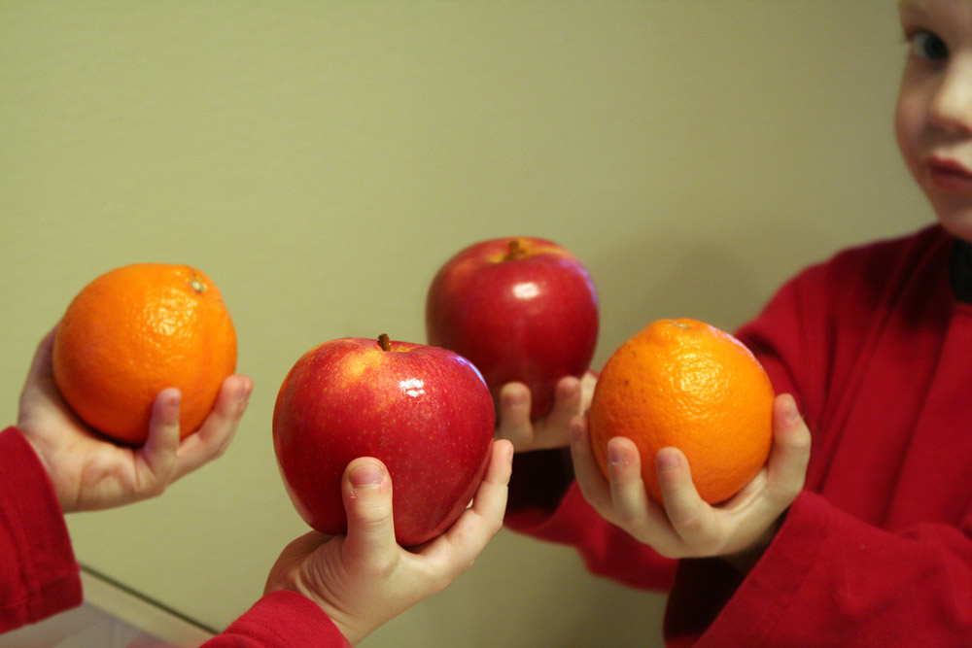
“Without adequate controls, all of the possible causes for learning differences between one medium and another cannot be explained adequately, and the researcher is left with the dilemma of concluding that apples (CALL), for example, are superior to oranges (the language lab)” (Pederson, 1988, p. 106)

Slide 4
The Problem (cont.)
Broad atheoretical CALL vs. non-CALL comparisons are still common
Most CALL research is not grounded in Second Language Acquisition (SLA) theory
The outcome measures employed in CALL studies often differ from those commonly use in SLA research
Methods are frequently not adequately reported to permit replication
(Macaro et al., 2012)

Slide 5
The Problem
Current approaches to CALL research “are encouraging an accumulation of vaguely inter-connected research findings rather than the construction of knowledge across independent studies” (Porte, 2013, p. 12) upon which the design of future CALL software and tasks can be designed.

Slide 6
Basic CALL research
Research
  designed “to discover something about how students best learn a language”
  which “provide[s] explanatory data and add[s] to the theoretical bases for second language learning”
  (Pederson, 1987, p. 125)

Slide 7
Forms of basic CALL research
Conventional approaches
  Exploratory research, i.e. ethnographic research
  Observational research, i.e. tracking/logging
  Narrowly focused experimental studies
    (Pederson, 1987)
More recently
  Design-based research
    (Yutdhana, 2008)
  Educational engineering
    (Colpaert, 2010)

Slide 8
Replication in CALL
Exact replication
  Employ an identical study design to verify findings
Instrumental replication
  Employ the same outcome measures to permit generalisation and comparison across studies
Conceptual replication
  Employ different methods to demonstrate validity
  (Polio, 2012; Porte & Richards, 2012)

Slide 9
The need for instrumental replication
Instrumental replications is essential to enable us to connect the findings of different CALL studies with one another and studies in the broader field of SLA, and construct an evidence base up on which to base the design of future CALL software

Slide 10
The IRIS database
Instruments for Research Into Second languages (IRIS)
Open-access digital repository
Creative commons licensing (promoting: derivatives allowed; non-commercial; share-alike)
Data collection instruments
Quality assured (peer-reviewed)
Up- and downloadable
Searchable

Slide 11
The IRIS databse (cont.)
270 data collection instruments
24 languages
38 language combinations
600 authors cited
74 journals
195 individuals
40 main instrument types
88 sub-types
Data covers 87 research areas
36 linguistic features

Slide 12
Motivation (22)
Identity (22) Strategies (18)
Tasks (86)
Information exchange (19)
Classroom (11)
Instruction (67)
Computer assisted language learning (2)
Processing (50)
Sentence processing (10)
Bilingualism (24)
Attrition (5)
Perception (5) Phonology (22)
Morpho-syntax (128)
Vocabulary (54)
Pragmatics (5)
Teacher education (6)
Policy (1)
Teacher cognition (1)

Slide 13
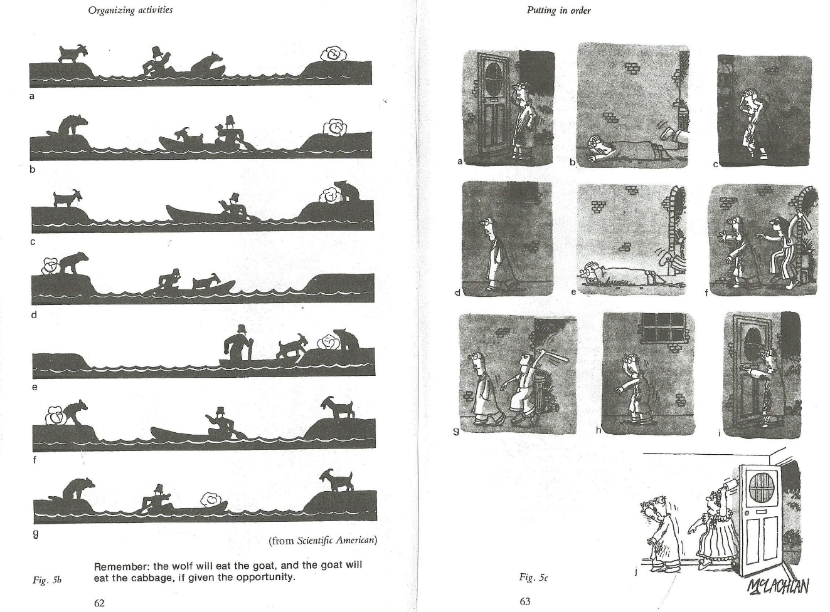
Task-Based Language Teaching
García Mayo’s(2005) decision-making task
Notes:
García Mayo, M. (2005). Interactional strategies for interlanguage communication: Do they provide evidence for attention to form? In A. Housen & M. Pierrard (Eds.), Investigations in instructed second language acquisition (Studies on Language Acquisition Series). Mouton de Gruyter.

Slide 14
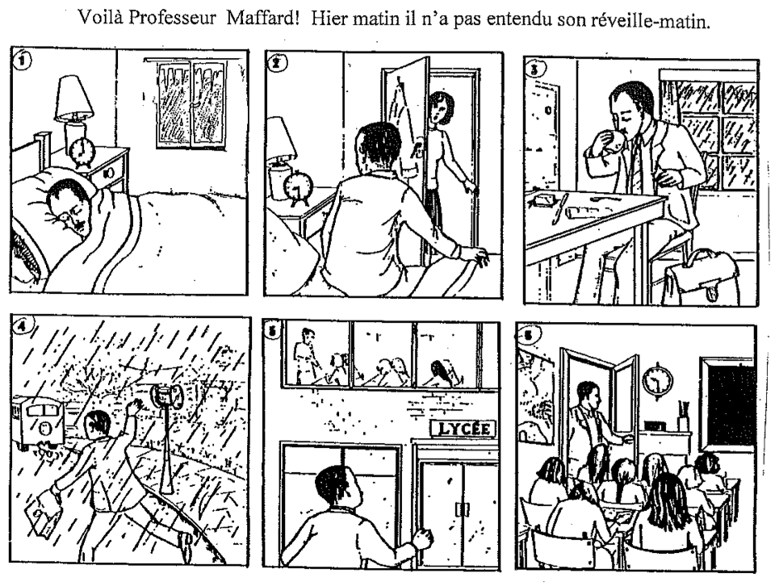
Task-Based Language Teaching
Mifka Profozic’s (2012) picture description tasks
Notes:
Mifka Profozic, N. (2012). Oral corrective feedback, individual differences and L2 acquisition of French past tenses. (Unpublished doctoral dissertation). University of Auckland.

Slide 15
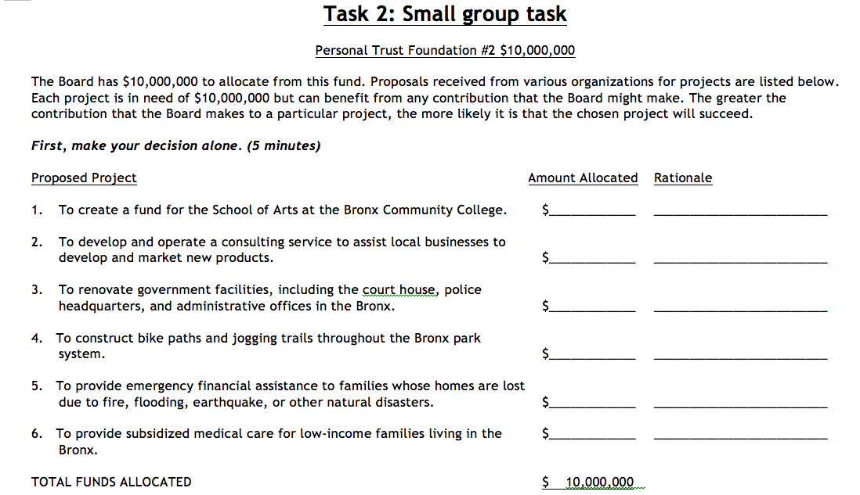
Task-Based Language Teaching
Révész’s (2011) argumentative tasks
Notes:
Révész, A. (2011). Task complexity, focus on L2 constructions, and individual differences: A classroom-based study. The Modern Language Journal, 95(4).

Slide 16
Conclusion
In order to provide a reliable evidence-base upon which to base future CALL design, more basic research, and replications thereof, is necessary.
To permit the necessary replication, CALL researchers are encouraged to contribute instruments from their peer-reviewed publications to the IRIS database.

Slide 17

EUROCALL 2014, Groningen, The Netherlands
IRIS is directed by Emma Marsden (York, UK) and Alison Mackey (Georgetown, USA / Lancaster, UK), and funded by the Economic and Social Research Council and the British Academy.
www.iris-database.org
Contacts:
zoe.handley@york.ac.uk & emma.marsden@york.ac.uk

Slide 18
References
Colpaert, J. (2010). Elicitation of language learners’ personal goals as design concepts. Innovation in language learning and teaching, 4(3) 259-274.
García Mayo, M. (2005). Interactional strategies for interlanguage communication: Do they provide evidence for attention to form? In A. Housen & M. Pierrard (Eds.), Investigations in instructed second language acquisition (Studies on Language Acquisition Series). Mouton de Gruyter.
Macaro, E., Handley, Z. L., & Walter, C. (2012). A systematic review of CALL in English as a second language: Focus on primary and secondary education. Language Teaching, 45(1), 1–43
Mifka Profozic, N. (2012). Oral corrective feedback, individual differences and L2 acquisition of French past tenses. (Unpublished doctoral dissertation). University of Auckland.

Slide 19
References
Pederson, K (1987). Research on CALL. In Smith, W. F. (ed.). Modern media in foreign language education: Theory and implementation (pp. 99–131). Lincolnwood, Illinois: National Textbook Company.
Polio, C. (2012). Replication in published applied linguistics research: A historical perspective. In Porte, G. (ed.). Replication research in applied linguistics (pp. 47-91). Cambridge: Cambridge University Press.
Porte, G. & Richards, K. (2012). Focus article: Replication in second language writing research. Journal of Second Language Writing, 21(3), 284-293
Révész, A. (2011). Task complexity, focus on L2 constructions, and individual differences: A classroom-based study. The Modern Language Journal, 95(4).
Yutdhana, S. (2008) Design-based research in CALL. In Egbert, J. L. & Petrie, G. M. (eds.). CALL research perspectives (pp. 169-178). Mahwah, NJ: Lawrence Erlbaum.

Slide 20
Bibliography
Marsden, E. & King, J. The Instruments for Research into Second Languages (IRIS) digital repository. The Language Teacher, 37(2), 35-38.
Marsden, E. J., & Mackey, A. (2014). IRIS: a new resource for second language research. Linguistic Approaches to Bilingualism, 4(1), 125-130.

