Slide 1


Of Guns, Glory Hunters and Good Intentions.
How Does France Do Everything It Does in Africa and Get Away With It?

Slide 2

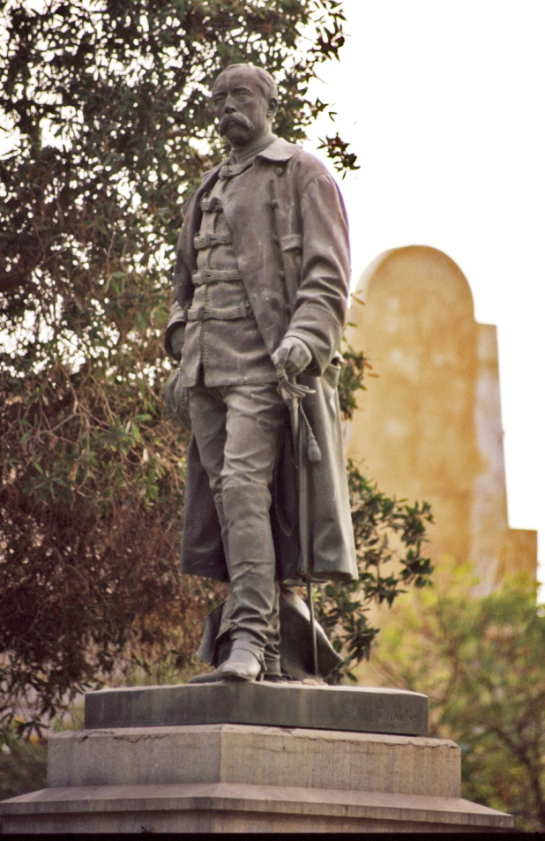
Louis César Faidherbe
Faidherbe Statue
Saint-Louis, Senegal

Slide 3
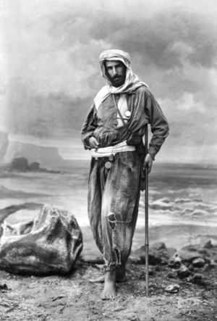

Pierre Savorgnan
De Brazza

Slide 4
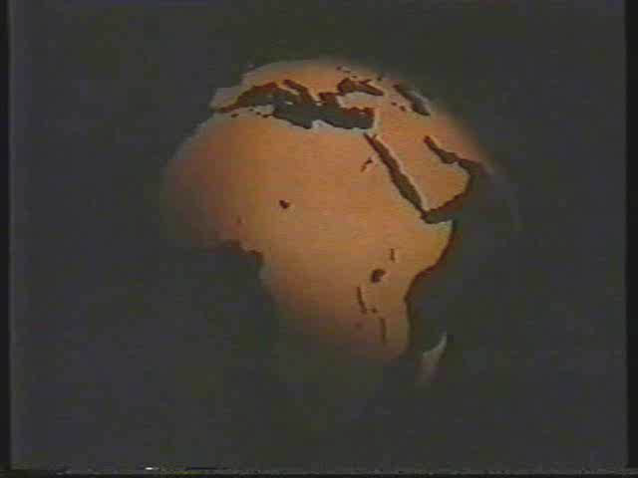

Slide 5
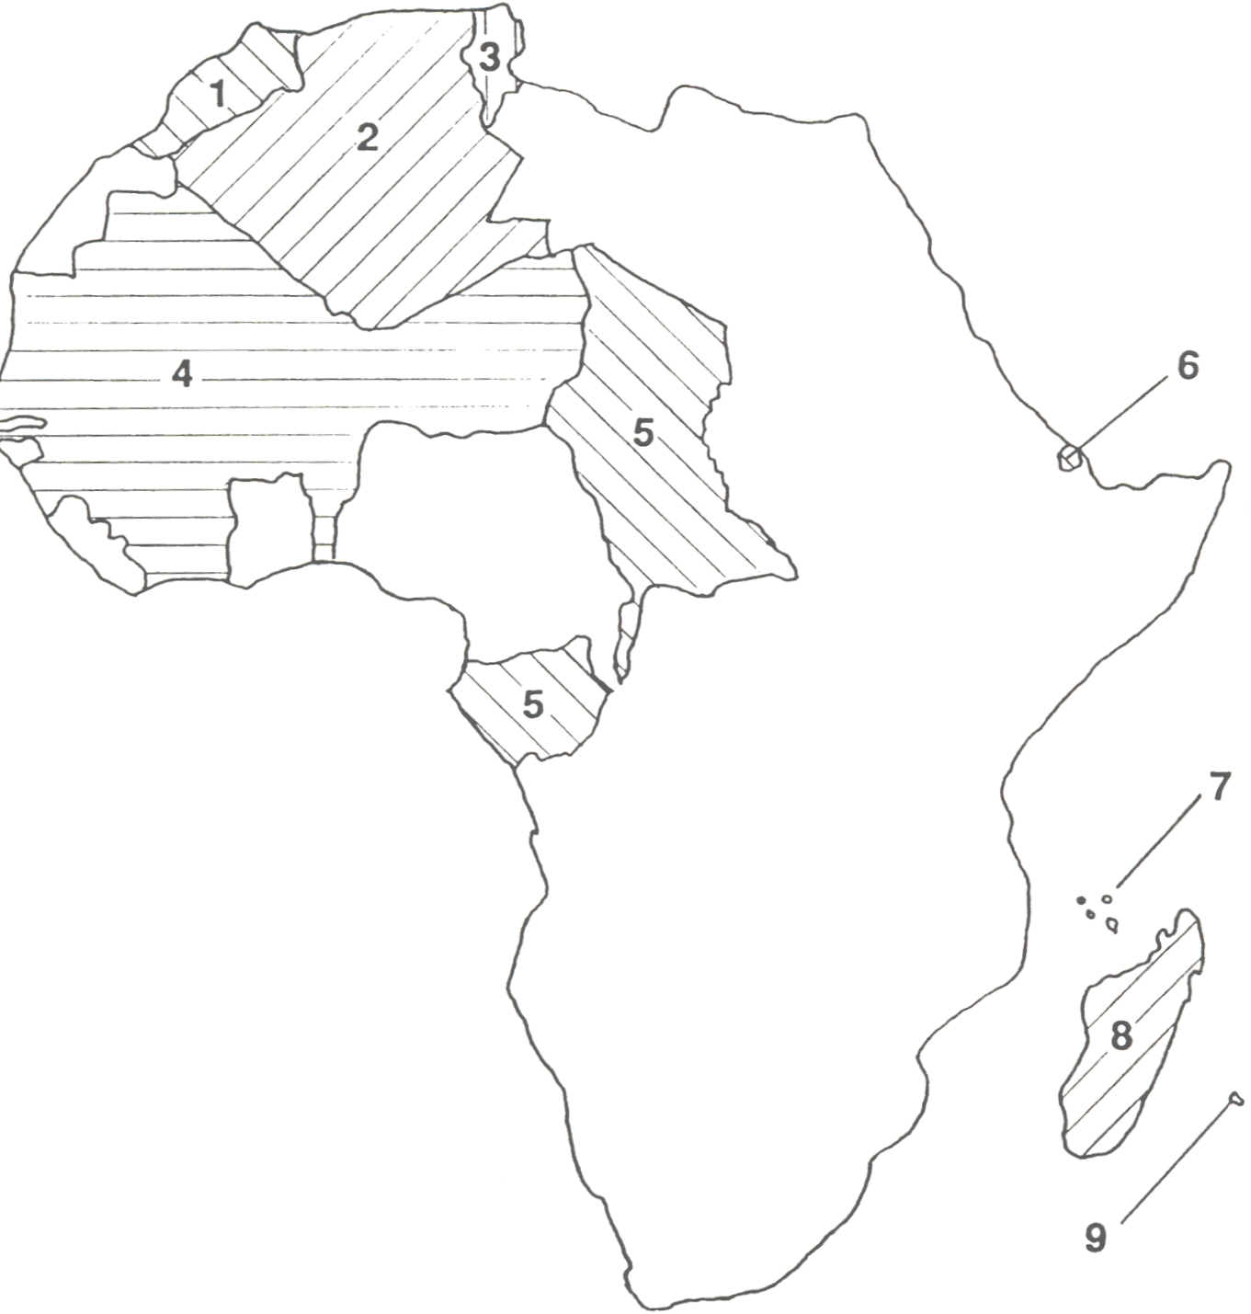
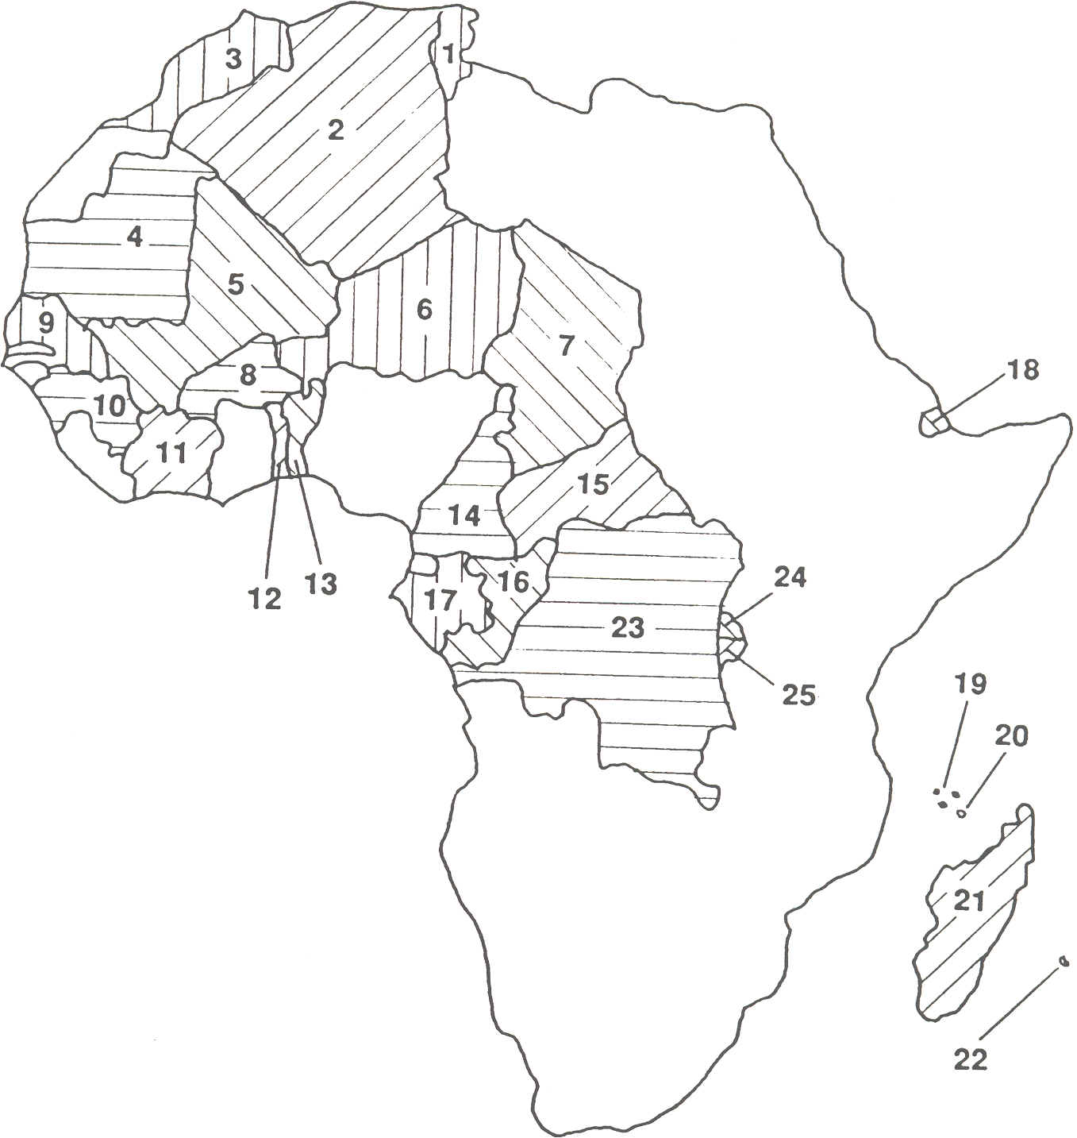
8 Madagascar 9 Reunion
25 Burundi
FRANCOPHONE AFRCA IN 1993
25 Burundi
FRENCH POSSESSIONS BEFORE THE OUTBREAK OF WORLD WAR I
FRANCOPHONE AFRICA IN 1993
Maps from boo
1 Morocco
2 Algeria
3 Tunisia
4 French West Africa
5 French Equatorial Africa
6 French Somaliland
7 Comoros
8 Madagascar
9 Réunion
1 Tunisia 7 Chad 13 Benin 2 Algeria 8 Burkina Faso 14 Cameroon 3 Morocco 9 Senegal 15 CAR 4 Mauritania 10 Guinea 16 Congo 5 Mali 11 Ivory Coast 17 Gabon 6 Niger 12 Togo 18 Djibouti
19 Comoros
20 Mayotte
21 Madagascar
22 Réunion
23 ZaIre
24 Rwanda
25 Burundi

Slide 6
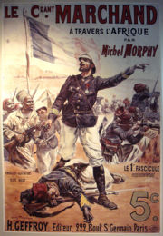
The Making of France’s African Empire
Not motivated by
economics
Key role of adventurers
and military men

Slide 7
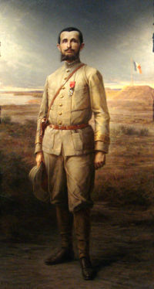
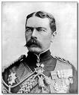
Fashoda
Lord Kitchener
Major Marchand

Slide 8
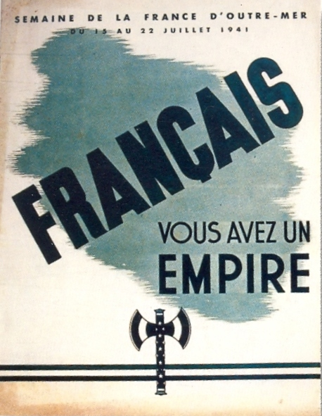
The Making of France’s African Empire
Public indifference to
empire - acquired in a
‘fit of absence of mind’
. . . but this changes
after World War II
'French people:
you have an empire'

Slide 9
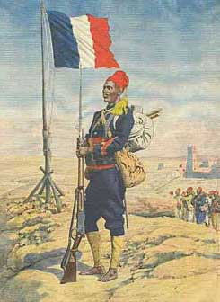
France’s African Troops – Les tirailleurs sénégalais
Role in the defence of
France in two world wars
Role in the Liberation of
France in World War II
‘Nos soldats d’Afrique –
Les tirailleurs sénégalais’
[‘Our African troops’]

Slide 10
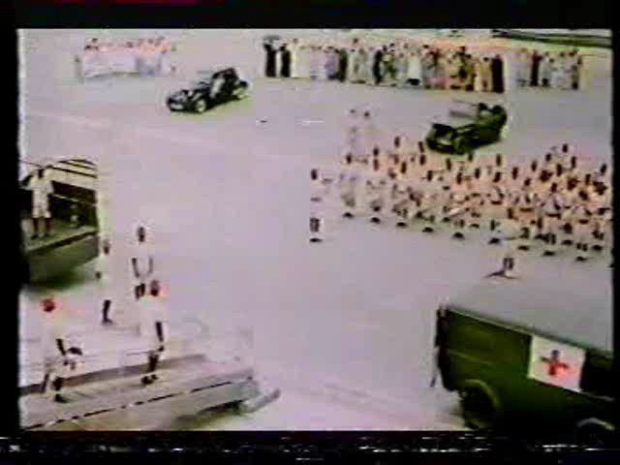

Slide 11
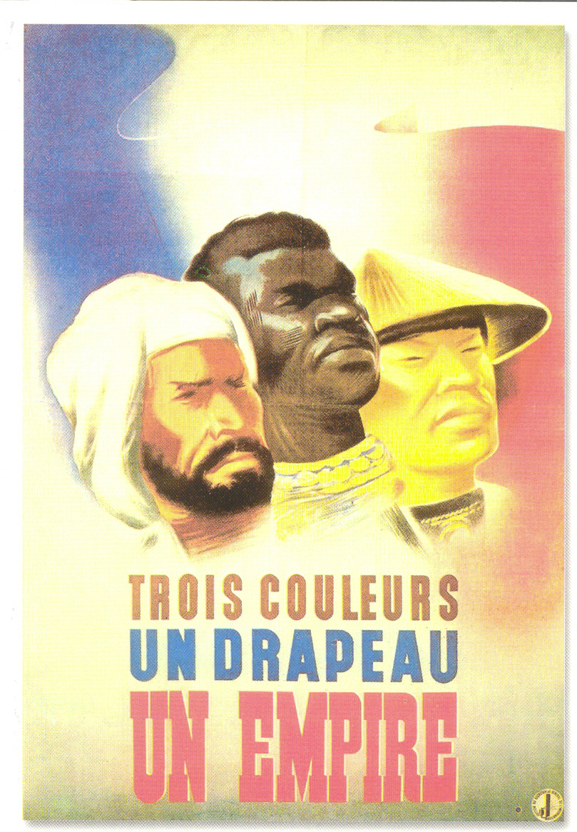

Slide 12

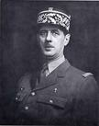
‘Eurafrique’: A New Partnership between France and Africa
The Empire becomes the French Union
The Colonies are renamed ‘Overseas France’
Colonial subjects become citizens of the French Union
General De Gaulle

Slide 13
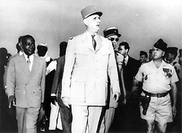
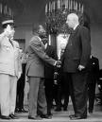
‘Eurafrique’: A New Partnership between France and Africa
De Gaulle and
Houphouët-Boigny
of Ivory Coast
De Gaulle and Senghor of Senegal

Slide 14
1960-94: The Golden Age of the ‘Special Relationship’
Cold War: France as ‘guarantor’ of Western interests in West & Central Africa
Pillars of the special relationship (1):
The Franc Zone: the CFA Franc
The Ministry of Cooperation – ‘Ministry for Francophone Africa’
Bilateral cultural, technical & defence accords

Slide 15
1960-94: The Golden Age of the ‘Special Relationship’
Pillars of the special relationship (2):
Bilateral cultural, technical & defence accords
Military interventions
Aid
‘Les coopérants’

Slide 16

1960-94: The Golden Age of the ‘Special Relationship’
Pillars of the special relationship (3):
Personal links – a ‘family-like’ relationship
Presidential special advisors:
Jacques Foccart and ‘les
réseaux’ (networks)
Mitterrand junior:
Jean-Christophe
Foccart & de Gaulle

Slide 17
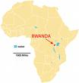
The Rwanda Watershed
French implication in the 1994 Genocide:
800,000 Rwandans killed
Aftermath of the genocide:
Opération Turquoise
France does not intervene
to ‘save’ its ally Mobutu
Instability throughout the
region
→ French loss of credibility

Slide 18
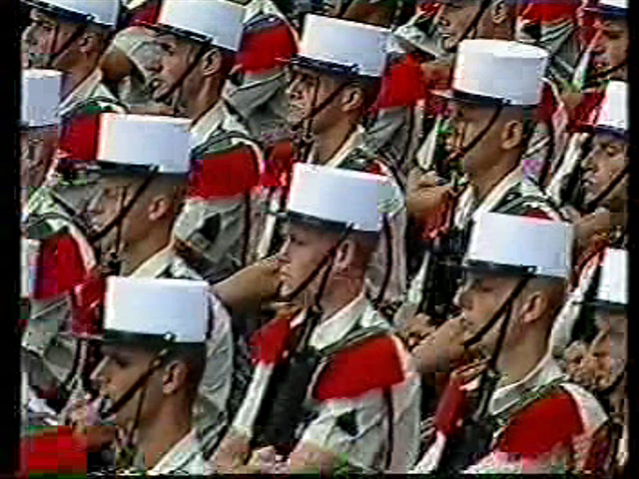
Notes:
Africa less important for France?

Slide 19
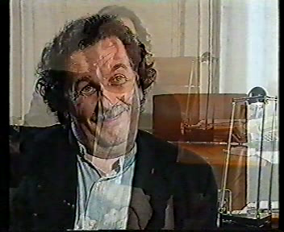

Slide 20
A New Approach after 1994
‘Europeanisation’ of military policy
National objectives in Africa pursued through
cooperation with other major powers
‘Humanitarian intervention’ replaces the
‘civilising mission’
Notes:
Africa less important for France?

Slide 21


Conclusion
French interest in Africa shows no sign of waning
Nicolas Sarkozy propose aux Africains de faire "l'Eurafrique"
Presidents Sarkozy & Wade in Dakar, July 2007
Le 26 juillet 2007

Slide 22
So How Does France Do Everything It Does in Africa – and Get Away With it?
France as champion of Third World – and particularly African – interests on the world stage
Consistency of commitment
The personal links
A multilayered relationship

