Slide 1
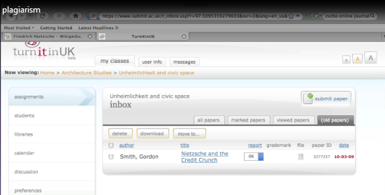
Learning not to plagiarise
‘Using Turnitin’ and ‘Humbox’
Sarah Hayes

Slide 2
This session will:-
Help students to understand what plagiarism is and how to avoid penalties
Look at subtle examples and see where these have been plagiarised
Try submitting a piece of work in Turnitin and receive feedback
Reuse materials from Humbox
Explain to students why re-using HumBox materials is NOT plagiarism!

Slide 3
Materials re-used for this session from HumBox are:-
Video demonstrating plagiarism detection using the Turn It In online service with thanks to the creator: Mr Robert Toole
Examples of plagiarism: (ref)
Referencing & Bibliographies - Learning Unit 5 with thanks to the creator: Mr Brett Lucas

Slide 4
Watch an example
Video demonstrating plagiarism detection with Turnitin
  Think about your own methods of working whilst watching this
  Discussion and comments

Slide 5
2 ways to use other’s materials
In your essay you can :
  Paraphrase their argument
    Or quote them directly.
Most people use a combination
Either way you must acknowledge your sources to avoid serious penalties for plagiarism

Slide 6
Consider: is this plagiarism?
Example 1 on the sheet you have been given. Yes? No? Why?
    Discuss with those next to you and note your decision
  Example 2 on the sheet you have been given. Yes? No? Why?
    Again, note your decision
  Here is the verdict- any surprises?

Slide 7
Write 300 words
You have been asked to write 300 words and reference at least twice both the articles and images you have been provided with
Use the referencing sheet to support your methods
We will submit these to Turnitin

Slide 8
Let’s challenge Turnitin

