Slide 1
Regulating Learners' Freedom: Fostering Language Learning Autonomy through Culture
The Spanish Language Portfolio at the University of Leeds
Antonio Martínez-Arboleda
Senior Teaching Fellow
University of Leeds
sllama@leeds.ac.uk
SMLC Language Teaching Workshop: Sharing Good Practice. School of Modern Languages and Cultures. University of Leeds . 23 June 2011

Slide 2
The Portfolio within the Language Modules
The module SPPO 1010 is assessed by:
a multiple choice test done during January examination period (15%)
a ‘tarea para casa’ done during the year (15%) 29th March 2011
a “Portfolio of Activities of Autonomous Learning” to be completed throughout the year in 4 instalments during the academic year (25%) (8th of Nov/10th Jan/7th March/10th May)
an oral examination in May based on the “Portfolio of Autonomous Learning” and oral exercises done during the year (15%) Week 10th of May
a written examination in May/June (30%).
Notes:
Let’s see how the portfolio fits in the module: The portfolio is a fully fledge member of the regulatory apparatus of the module. But it is only part of a taught module where there is variety of assessment methods.

Slide 3

The Working and Structure of the Portfolio
Self-questionnaire about their linguistic competence and personal learning objectives
Workshops
Activities
Worksheets
Points and word limits
Description of the work carried out
Learning reflection
There is feedback and assessment on language, content and quality of learning reflection.
Rules on variety
Notes:
So let see what is about:
It is Ikea learning, you can combine with so many different pieces your own wardrobes and shelves. But the pieces are “partly” self-made by students.
The rules tell them the format of the basic framework of the learning experience, not the content.
Students need to complete a self-questionnaire about their linguistic competence and learning objectives at the beginning of the year, which they later include in their first submission.
We organise workshops on how to make the most of the activities, show them the different worksheets, and explain how to complete the worksheets and the different forms in this programme. Students get on with the activity happily. So, for instance, one of them decides to go to a conference and watch a film...They know that there are worksheets to look at and complete after the experience.
Every time a student submits one of the parts of the portfolio, she is supposed to introduce a comprehensive learning reflection and a description of the work carried out alongside the worksheets she has decided to complete.
Each part of the portfolio, when students submit it, is made up of the worksheets completed by the students some ad-hoc, some generic, which are given different points and a word limit.
There is feedback on language, content and quality of learning reflection.
To recap:
The portfolio is made up of worksheets that student complete.
Each type of activity has at least one generic worksheet.
Each worksheet is worth a number of points (a conference is worth 25 points, for instance).
Each worksheet has got a word limit.
Each worksheet has a number of set questions, but students have relative freedom to stick to some of them.

Slide 4
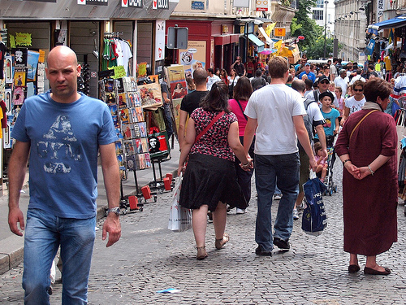
Learners' Freedom and Learners’ Autonomy
Benson (2008 : 29-30)
Learning situations or behaviours have no intrinsic relationship to personal autonomy. This is explained in the context of the person who chooses to take a course in carpentry, in reference to Dickinson’s work. By accepting to attend classes in carpentry and being part of a programme, that person is accepting a limitation in his freedom.
For Benson, that person who takes the course is relinquishing his “situational freedom”, rather than his autonomy. The reason is that for Benson, learner autonomy is connected to the “overall development” of the individual autonomy of the learner in their personal life.
Benson (2008 : 19)
“The kinds of learning that lead to autonomy”
Notes:
Thank you Mustapha for this fantastic initiative. This is the fourth presentation related to autonomous learning using the Spanish Language Portfolio in the last 2 years. (Leeds, Leeds Met, Newcastle and Leeds Uni). I know some of you have been to some of them already and that some of you know well the portfolio, so I promise this one will be different to the others, although you may notice some resemblance with the PP style.
If you look at the title of the presentation there are two words whose meaning has been analysed and discussed widely in the discipline. I have chosen them deliberately because there is one author, in my view, who distinguishes them very well. His name is Phil Benson, who has an article here. In his article, Phil differentiates between the two in the following way:
Learners Autonomy is concerned with the overall development of the individuals in their personal lives, outside the classroom and beyond formal education. He makes this point in response to Dickinson’s claims, who, when talking about learners’ autonomy, makes the following comment:
Someone who decides to take a course in carpentry in a college, is actually limiting his own autonomy as a learner, as many of his decisions as a learner are going to be taken by the tutor or even have been taken by the programme manager of the course.
To that claim, Benson response is that that student is accepting a limitation on his situational freedom, not his autonomy because, (my addition) autonomy seems to be conceived by Benson as an aspiration in life.
This is obviously a very interesting point that has been developed by the author and I would like encourage everyone to read this book, as soon as I return it.
So what’s the connection with the Portfolio in Spanish?

Slide 5
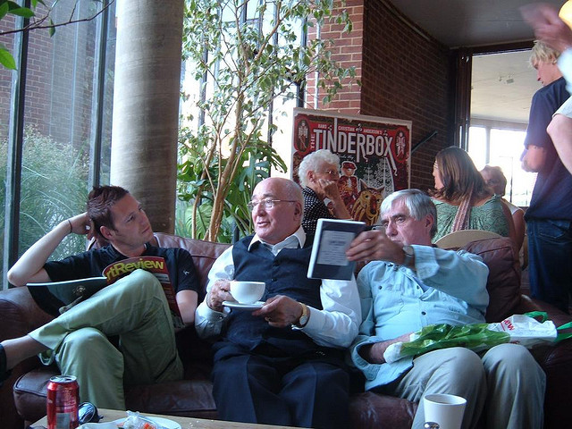
Learners' Freedom and Learners’ Autonomy
The portfolio places constraints on the situational freedom of the student, but help them to achieve autonomy.
Our students have chosen to study a degree in Spanish Language and Culture.
Being able to enjoy and appreciate authentic samples of uncut cultural production and being able to share their thoughts with others is key for their future personal autonomy in life. (Approaching independently cultural production in their BA and in their YA)
Notes:
If you look at our portfolio of autonomous learning, it has a very regulated structure: it’s made up of worksheets for each type of autonomous learning activities, there are points given for each worksheets, there are deadlines and submissions, word limits, rules about variety…someone could say very easily: you are destroying learners autonomy. Autonomy is about that: go to the library and find your way through life by yourself…Or Holec “you can’t regulate autonomy”
Well, that is a point of view widely held still by some colleagues in HE, although not so crudely expressed, which can be disputed with Benson’s distinction: The portfolio places constraints on the situational freedom of the student, but not on their autonomy. In fact, if we think about autonomy the way Benson describes it, we are targeting very well our efforts with the portfolio in terms of “fostering learners autonomy”. Why?
Because the portfolio is about watching films that you have chosen to watch, reading books that interest you, beyond your immediate academic interests, discussing in the target language questions about society or public life, attending talks that are not part of the syllabus, etc. So, if we think about our students as individuals who have chosen to study Spanish Language and Spanish Culture, Being able to enjoy and appreciate authentic samples of uncut cultural production is key for their future personal autonomy in life, in many cases, professional life.

Slide 6
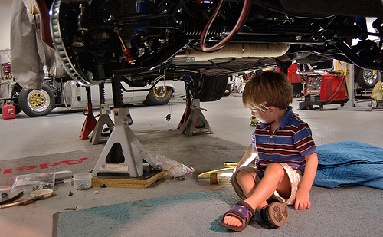
Independence, self-management and reflection
Crome, Farrar and O'Connor (2009 : 5)
Autonomy of learning : “the ability to think and act critically and independently, to self-manage study and learning, and realistically to appraise one's strengths and weaknesses as a learner”
In that respect, we can say that in this Portfolio students choose the activities. They self-direct and managed their learning to a greater extent than in fixed curricula.
They assess their skills, they reflect on their learning.
The questions in many sheets are open invitations to reflect critically upon what they have heard, seen or read.
Notes:
‘Autonomy of learning’ “the ability to think and act critically and independently, to self-manage study and learning, and realistically to appraise one's strengths and weaknesses as a learner” is not simply one transferable skill among others; rather, it is a disposition towards learning that is integral to the acquisition of all other skills and knowledge.
the inculcation of the habit of autonomous learning cannot be achieved simply by repetition through practice. Rather, the repetition must itself be undertaken because the student desires to learn independently. In that case, does not conceiving autonomous learning as a habitually acquired
disposition at best simply push the problem one stage back, since the student either has the desire to learn independently or does not? In answer to this, it is necessary to recognise that desires and habits are one in the sense that although they are conceptually distinguishable, they are existentially reciprocally dependent: desires inform and motivate habits, whilst habits generate, form, and deform desires. In other words, repetition becomes a habit in the sense that it shapes desire, whilst without the desire the habit will not stick, a point made by Aristotle.

Slide 7
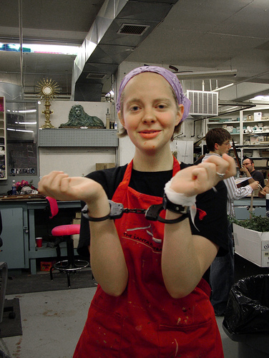
Independence, self-management and reflection
However,
How much more independence
would they have liked to have had in Year 1?
How much more independence do
they feel capable of handling in Year 2?
The answer: May 2010 Portfolio Survey
Notes:
That’s one of the questions I have studied through my 2010 portfolio survey.
‘Autonomy of learning’ “the ability to think and act critically and independently, to self-manage study and learning, and realistically to appraise one's strengths and weaknesses as a learner” is not simply one transferable skill among others; rather, it is a disposition towards learning that is integral to the acquisition of all other skills and knowledge.
the inculcation of the habit of autonomous learning cannot be achieved simply by repetition through practice. Rather, the repetition must itself be undertaken because the student desires to learn independently. In that case, does not conceiving autonomous learning as a habitually acquired
disposition at best simply push the problem one stage back, since the student either has the desire to learn independently or does not? In answer to this, it is necessary to recognise that desires and habits are one in the sense that although they are conceptually distinguishable, they are existentially reciprocally dependent: desires inform and motivate habits, whilst habits generate, form, and deform desires. In other words, repetition becomes a habit in the sense that it shapes desire, whilst without the desire the habit will not stick, a point made by Aristotle.

Slide 8

Autonomy as a something else than a skill
We need to bring at this point again, another interesting reflection from Crome, Farrar and O’Connor:
Learning autonomy is “an acquired disposition, a second nature, and therefore is neither voluntary nor involuntary”.
Crome, Farrar and O'Connor (2009 : 5)
And in relation to this, some of the answers to the questions I asked in the May 2010 Portfolio Survey can throw some light.
Notes:
That’s one of the questions I have studied through my 2010 portfolio survey.
‘Autonomy of learning’ “the ability to think and act critically and independently, to self-manage study and learning, and realistically to appraise one's strengths and weaknesses as a learner” is not simply one transferable skill among others; rather, it is a disposition towards learning that is integral to the acquisition of all other skills and knowledge.
the inculcation of the habit of autonomous learning cannot be achieved simply by repetition through practice. Rather, the repetition must itself be undertaken because the student desires to learn independently. In that case, does not conceiving autonomous learning as a habitually acquired
disposition at best simply push the problem one stage back, since the student either has the desire to learn independently or does not? In answer to this, it is necessary to recognise that desires and habits are one in the sense that although they are conceptually distinguishable, they are existentially reciprocally dependent: desires inform and motivate habits, whilst habits generate, form, and deform desires. In other words, repetition becomes a habit in the sense that it shapes desire, whilst without the desire the habit will not stick, a point made by Aristotle.

Slide 9
Learner’s disposition
Crome, Farrar and O'Connor (2009 : 5)
The inculcation of the habit of autonomous learning cannot be achieved simply by repetition through practice. Rather, the repetition must itself be undertaken because the student desires to learn independently.
It is necessary to recognise that desires and habits are one in the sense that although they are conceptually distinguishable, they are existentially reciprocally dependent: desires inform and motivate habits, whilst habits generate, form, and deform desires. In other words, repetition becomes a habit in the sense that it shapes desire, whilst without the desire the habit will not stick, a point made by Aristotle.
Notes:
‘Autonomy of learning’ “the ability to think and act critically and independently, to self-manage study and learning, and realistically to appraise one's strengths and weaknesses as a learner” is not simply one transferable skill among others; rather, it is a disposition towards learning that is integral to the acquisition of all other skills and knowledge.
the inculcation of the habit of autonomous learning cannot be achieved simply by repetition through practice. Rather, the repetition must itself be undertaken because the student desires to learn independently. In that case, does not conceiving autonomous learning as a habitually acquired
disposition at best simply push the problem one stage back, since the student either has the desire to learn independently or does not? In answer to this, it is necessary to recognise that desires and habits are one in the sense that although they are conceptually distinguishable, they are existentially reciprocally dependent: desires inform and motivate habits, whilst habits generate, form, and deform desires. In other words, repetition becomes a habit in the sense that it shapes desire, whilst without the desire the habit will not stick, a point made by Aristotle.

Slide 10
Present and Future of the Spanish Portfolio
Wider range of skills are now covered throughout the portfolio
Personalised learning: more variety of worksheets = more freedom to choose
Feedback enhanced - solid framework for reflection - online submission
Support and involvement of language teaching fellows
The future
Video Submission - Authenticity - A more Social Autonomous Language Learning. See Language Box activity on the book Manolito Gafotas: http://languagebox.eprints.org/833/

Slide 11
Conclusions – Recommendations for Practitioners
Compulsory autonomous language learning programmes with cultural component for all the students in B2 CEFR in HE language modules . There are formulae to introduce this type of portfolio for lower levels.
The introduction of points, the definition of a clear reward in terms of academic results and some kind of estimate in terms of hours or word limit, quantification.
Ongoing submission and monitoring
Integrated approach: linguistic competence (language) + culture (choice – personal interest) + learning reflection
Look at the structure of the portfolio: many of the learning activities that our students are supposed to do within non-language modules are “portfoliable”.
Shared “instructionalisation” of expressive objectives
Work that is relevant for the community or their peers and is going to be visible at some point to them.

Slide 12
References and acknowledgments
Materials shown in this presentation: Handing sheet and questionnaire produced by María García Florenciano, Bettina Hermoso Gómez, Antonio Martínez-Arboleda and Juan Muñoz López in 2008. Conference worksheet produced by Antonio Martínez-Arboleda in 2002. Rodrigo Malstems’ conference worksheet produced by Ben Bollig in 2011. Colleagues who have produced worksheets for the portfolio since 2002: Ben Bollig, Daniel Campos, Ramiro Cebreiros, Vanesa Fernández Rios, María García Florenciano, Stuart Green, Paula González, Bettina Hermoso Gómez, Antonio Martínez-Arboleda, Juan Muñoz López and Marién Pereira.
Benson, P. 2008. “Teachers’ and learners’ perspectives on autonomy” in Learner and Teacher Autonomy: Concepts, realities and responses, Lamb, T. and Reinders, H. (eds). AILA Applied Linguistics Series 1. Amsterdam: John Benjamins.
Crome, K., Farrar, R.and O'Connor P. 2009. “What is Autonomous Learning?” Discourse. Vol. 9,N. 1. Available from http://prs.heacademy.ac.uk/view.html/PrsDiscourseArticles/113 [Accessed 25 May 2011]
Martínez-Arboleda, A. 2010. "Autonomous Learning Portfolio in Spanish: Personalised Learning and Motivation in a Regulated Learning Environment". LLAS Conference: Supporting students' learning outside the classroom: promoting independence and autonomy in LLAS disciplines. Available from http://humbox.ac.uk/2230/ [Accessed 20 May 2011]
Pictures downloaded from Flickr.com (Creative Commons - Attribution Only – Non Commercial Use). Credits in order of appearance:
-University of Denver: Slide 3 (Students)
Zoetnet: Slide 4 (Man in street)
-Elsie Esq: Slide 5 (Boy in theatre)
-Nikki McLeod: Slide 6 (Child under car)
-Eqqman: Slide 7 (Girl in chains)
-Photo Phoenix : Slide 8 (Woman choosing)

